Slide 1
Capstone Project-2
Bike Sharing Demand Prediction By Name: Md Sohail Tanveer

Slide 2
Table of Content
Business Context
Data description
Project architecture
Pre-Processing
Exploratory Data Analysis
Feature Engineering
Model Implementation
Model Explainability
Conclusion

Slide 3
Business Context
Currently, Rental bikes are introduced in many urban cities for the enhancement of mobility comfort.
It is important to make the rental bike available and accessible to the public at the right time as it lessens the waiting time.
Eventually, providing the city with a stable supply of rental bikes becomes a major concern. The crucial part is the prediction of the bike count required at each hour for the stable supply of rental bikes.

Slide 4
Data Description
This dataset has around 8760 observations in it with 14 columns and it is a mix of categorical and numeric values.
The dataset contains weather information (Temperature, Humidity, Windspeed, Visibility, Dewpoint, Solar radiation, Snowfall, Rainfall), the number of bikes rented per hour, and date information.

Slide 5
Features Definition
Date: year-month-day
Rented Bike count - Count of bikes rented at each hour
Hour - Total hours rented for the day
Temperature-Temperature of that day in Celsius
Humidity - %
Windspeed - m/s
Visibility - 10m

Slide 6
Dew point temperature - Indicate the dew point temperature in Celsius
Solar radiation - MJ/m2
Rainfall - mm
Snowfall - cm
Seasons - Winter, Spring, Summer, Autumn
Holiday - Holiday/No holiday
Functional Day - NoFunc(Non Functional Hours), Fun(Functional hours)

Slide 7
Main libraries used:
Pandas for data manipulation and aggregation
NumPy for computationally efficient operation
Matplotlib and Seaborn for visualization and behaviour with respect to the target variable.
Folium used for map generation using latitude and longitude.

Slide 8
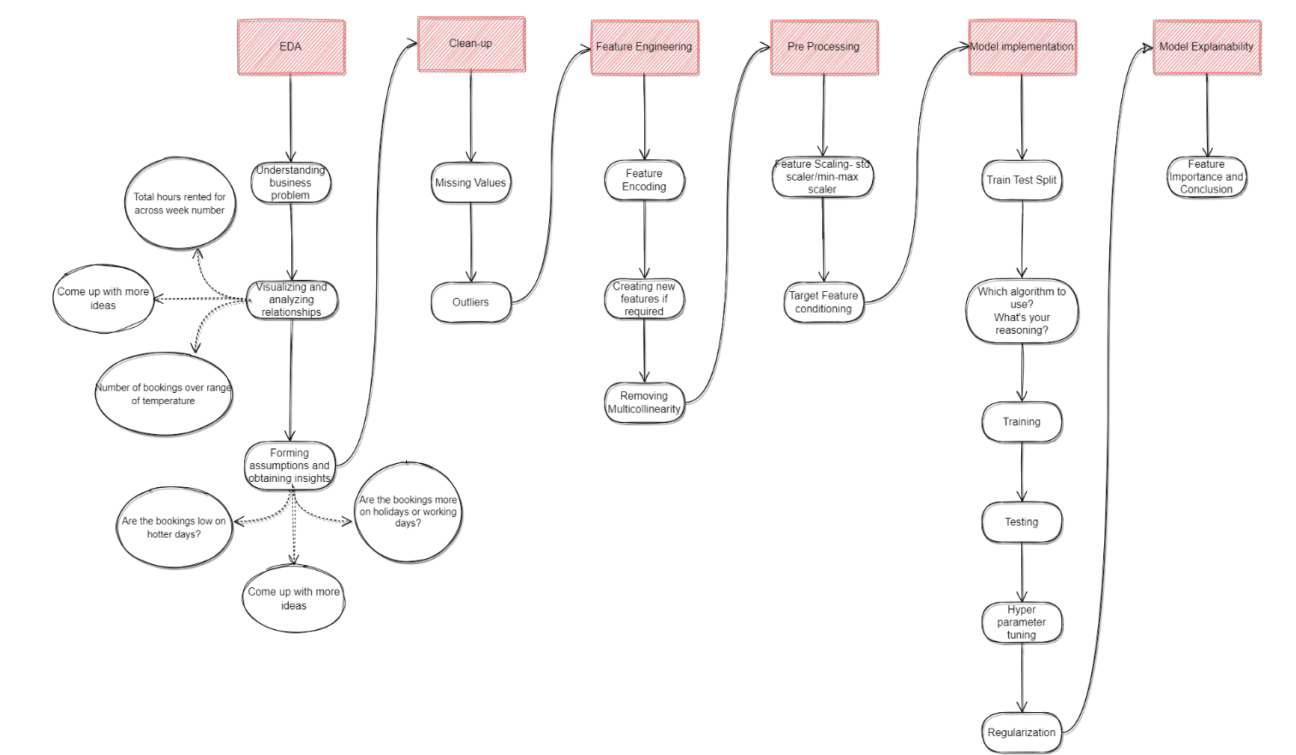
Project Architecture

Slide 9
1. Pre-Processing
Mounting drive
Importing important libraries
Loading dataset
Checking for NULL values
Handling NULL Values

Slide 10
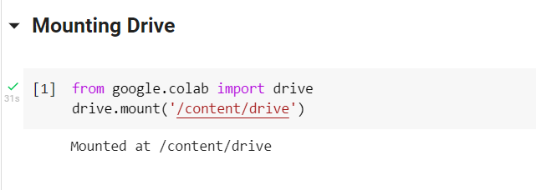
Mounting Drive
We mount the drive so that we can import our data set from google drive easily, It can be done by the two lines of code given below.

Slide 11
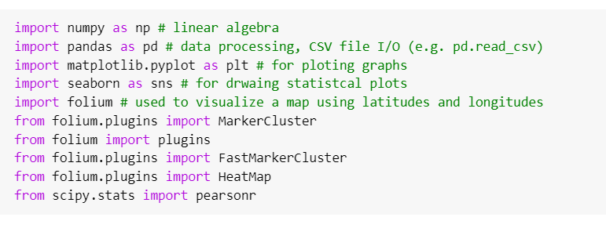
Importing Libraries
Importing Libraries is the most important part of preprocessing because it helps in structuring your code effectively.

Slide 12
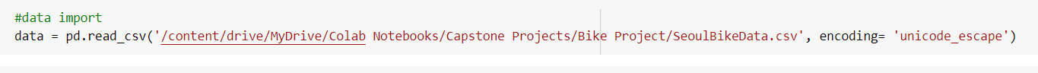
Loading Dataset
First we copy the path of the dataset from google drive and then stored it in a variable called path.
Now we use the second line of code to load the dataset.

Slide 13
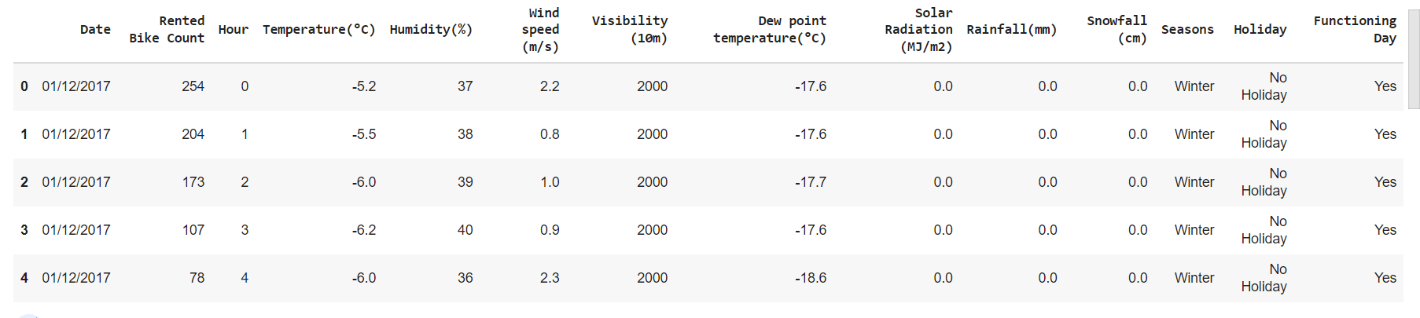
Dataset preview
Using the .head( ) method we will see the first five observations of the dataset.

Slide 14
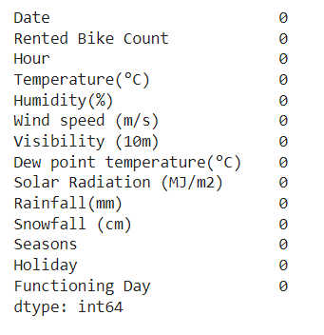
Checking NULL values
There are no NULL values in any of the columns.
The data is consistent and ready to use for various EDA.
All the pre-processing work has been done and now the data is ready for analysis.

Slide 15
2. Exploratory Data Analysis:
An EDA is a thorough examination meant to uncover the underlying structure of a data set and is important for a company because it exposes trends, patterns, and relationships that are not readily apparent.
2.1 Statistical Analysis
2.2 Categorical Feature EDA
2.3 Continuous Feature EDA

Slide 16
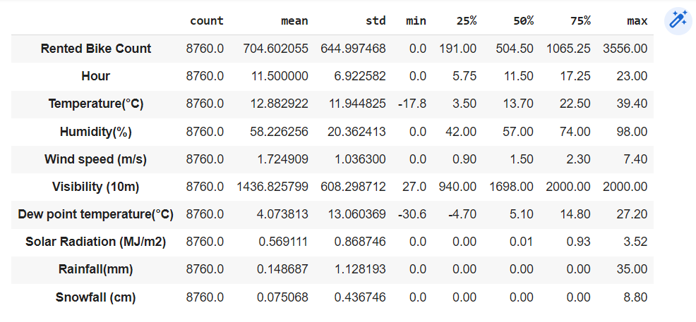
2.1 Statistical Analysis
Here, we did not find any unusual behaviour or pattern in our dataset. The whole dataset is statistically correct and ready to use for modelling.

Slide 17
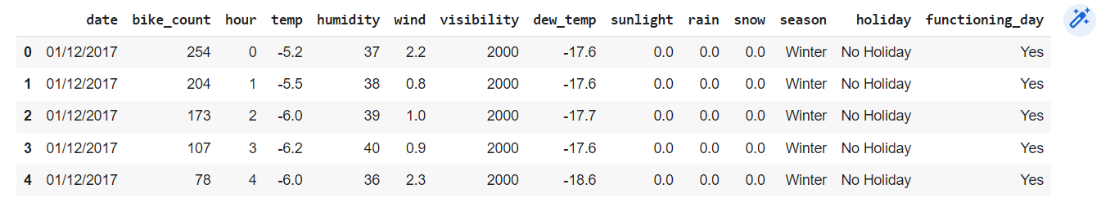
Let's rename the columns for easy understanding
After the columns renaming the data preview is given below, Now it’s easy to understand the features.

Slide 18
2.2 Categorical Features EDA
A categorical variable is a variable that can take on one of a limited, and usually fixed, the number of possible values, assigning each individual or other unit of observation to a particular group or nominal category on the basis of some qualitative property.
Here we have 3 categorical variables Holiday, Season, and Functioning Day.
We will see the distribution of our target variable over these three categorical variables in the next slides and try to find some conclusion.

Slide 19
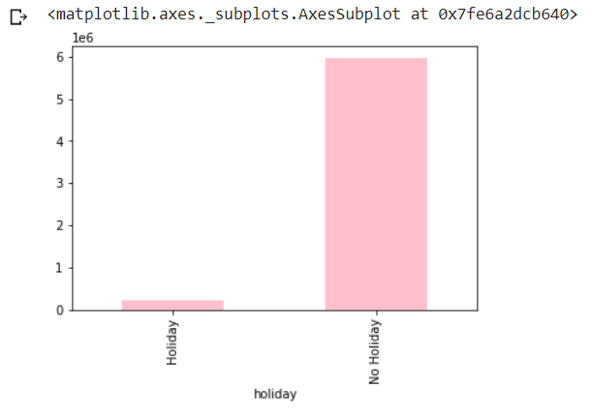
Bike renting counts on holiday and Non-holiday
From the graph, it can be observed easily that people do not use rented vehicles on Holidays.
Only on working days do people use rented bikes so that they can save time and money.

Slide 20
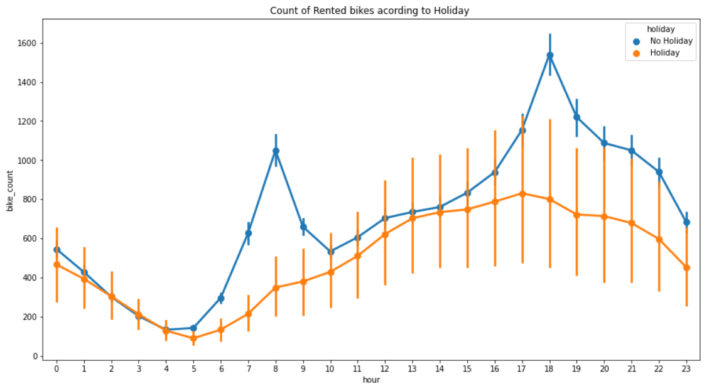
Count of Rented bikes according to Holiday
On a Non-holiday, rented bike demand surges twice a day, First from 6 to 8 am and second from 4 pm to 7 pm.
On holiday, rented bike demand increases slowly from 6 am to 3 pm and then starts decreasing.

Slide 21
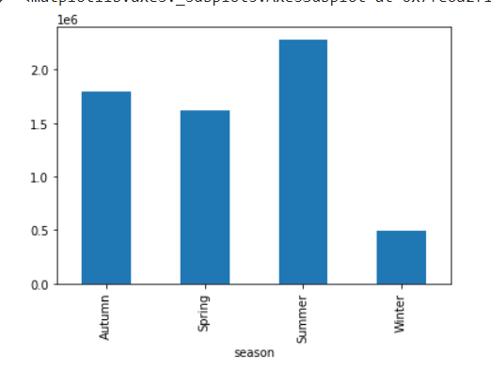
Bike Renting Count according to seasons
Bike rented count in Summer is very high, which suggests that people like to travel a lot in Summer while in winter bike rented count is less, and people don’t prefer traveling on a bike in this season.
Autumn and Spring seasons have almost similar bike rented count, So there is a moderate effect of these two seasons on the business.

Slide 22
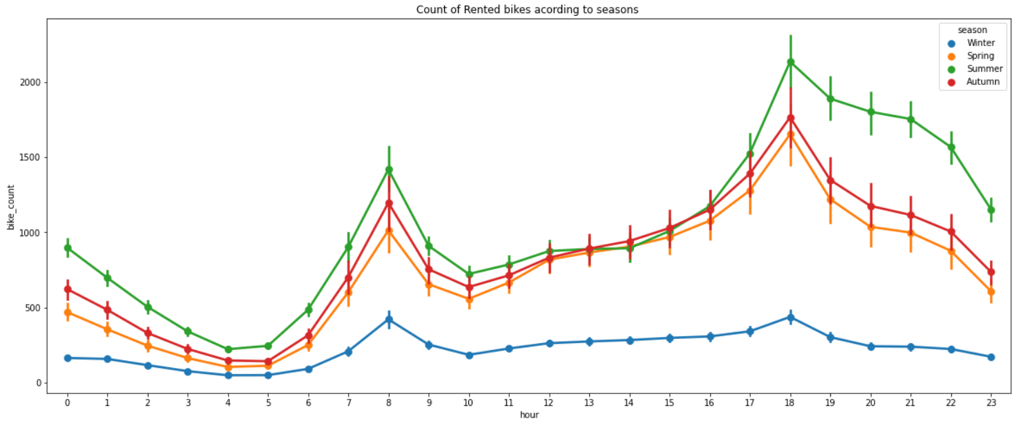
Rented bike count during the day in seasons
The is not much effect of season on booking time, all the graph shows the same pattern except winter. In winter the booking rate is comparatively slowest.

Slide 23
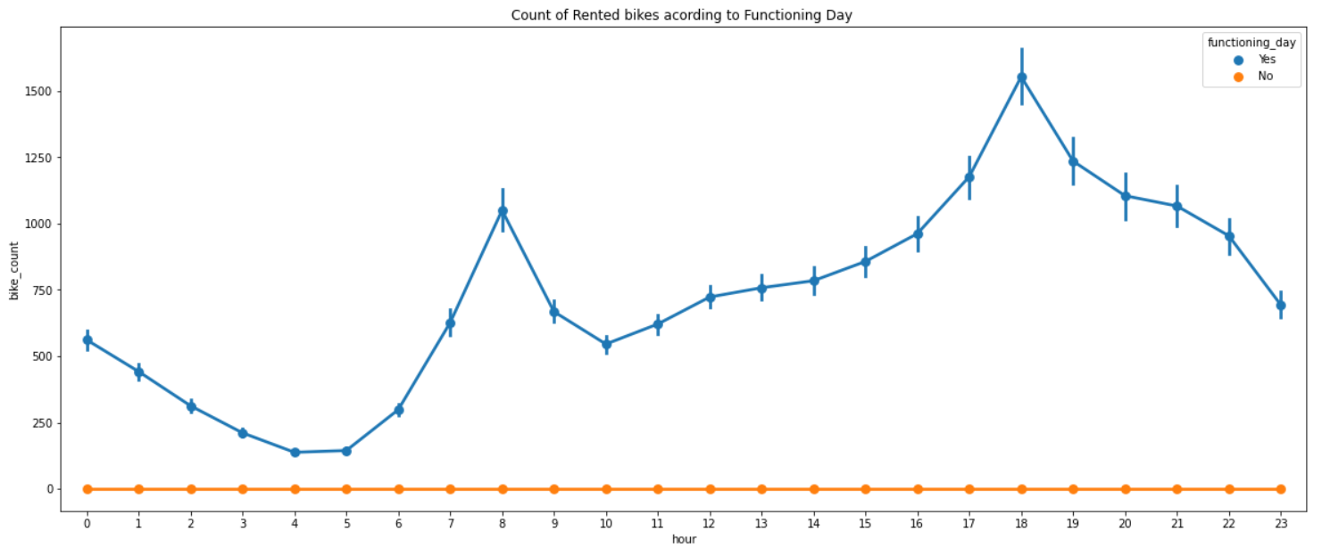
Bike rent count on functioning day or Non functioning day

Slide 24
2.3 Continuous Feature EDA
A quantitative variable may be continuous or discrete if they are typically obtained by measuring or counting, respectively.
Here we have continuous variables like temperature, humidity, wind speed, Snowfall, Rainfall, Visibility, and Sunlight.
We will see the distribution of our target variable over these continuous variables in the next slides and try to find some conclusion.

Slide 25
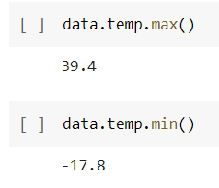
Bike rent count over temperature
The maximum temperature is 39.4 and the minimum temperature is -17.8 degree Celsius.
So the bike renting will be done between these temperatures.
Let’s draw a point plot to check the pattern of bike renting count while temperature increases.

Slide 26
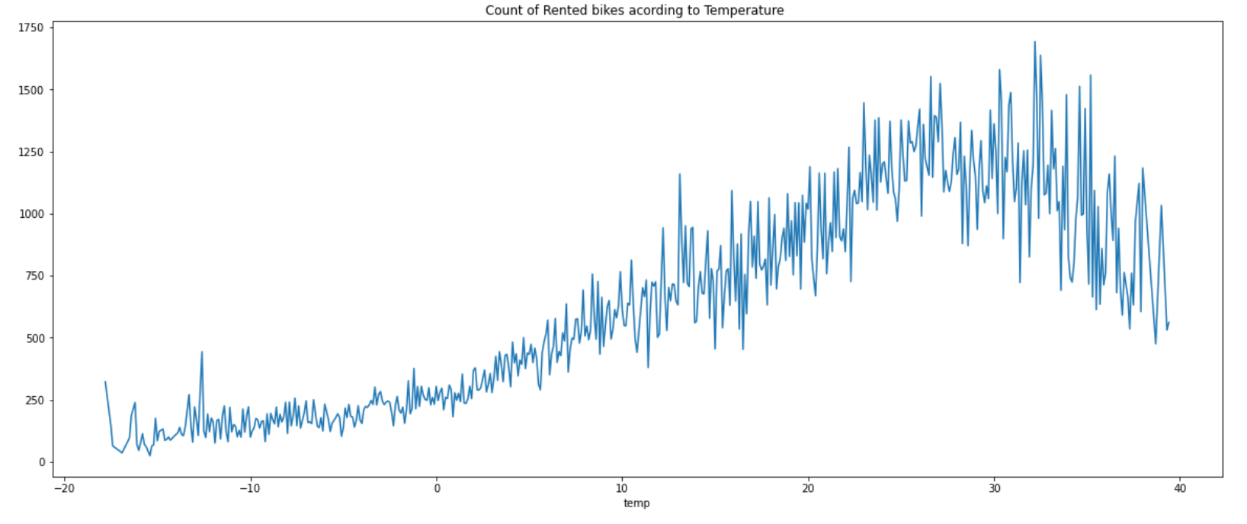
Bike rent count increase as the temperature increases but after a certain temperature it starts decreasing, it may be because of the hot environment people don’t like to travel on a bike.

Slide 27
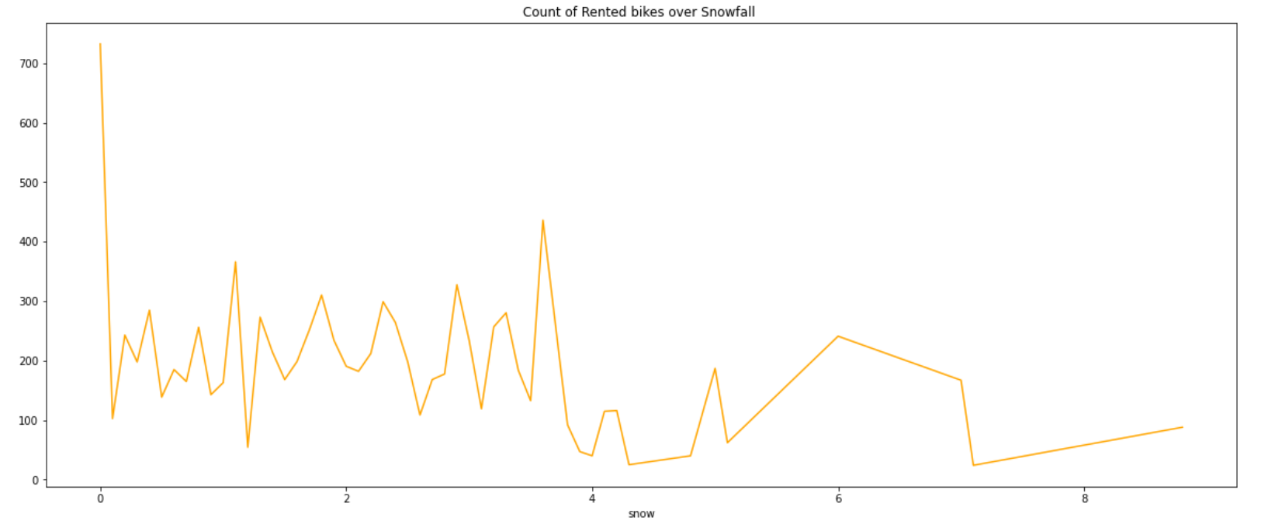
Bike rent count over Snowfall
We can clearly see that the number of rented bikes decreases with increasing Snowfall.

Slide 28
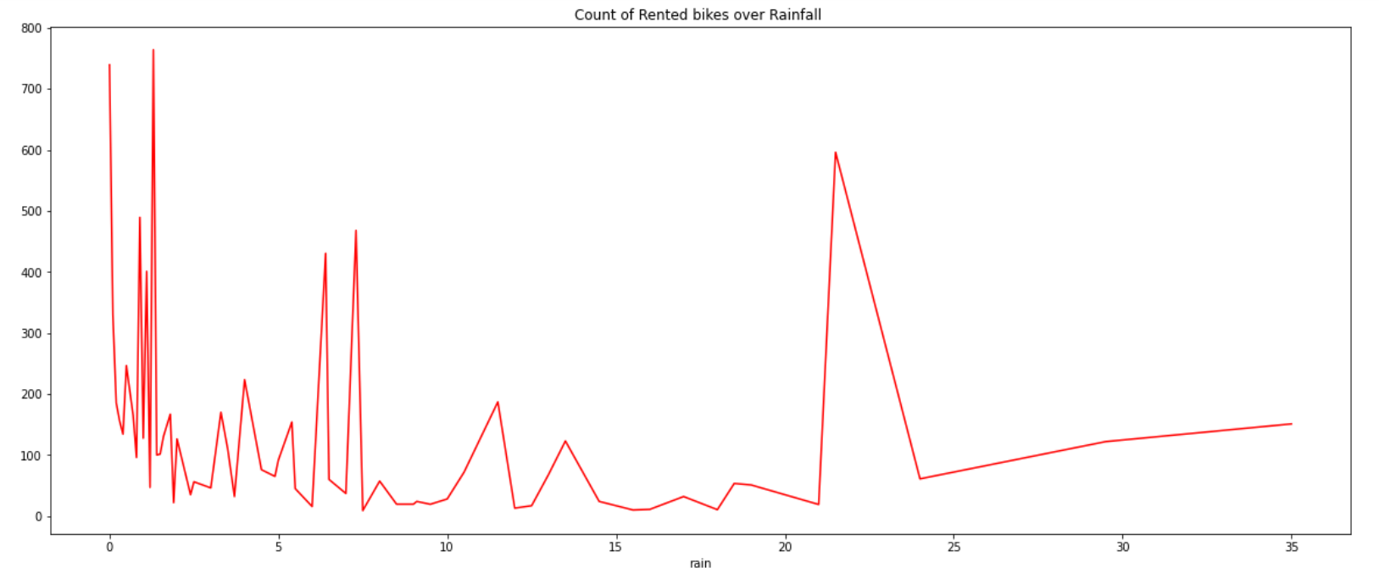
Bike rent count over Rainfall
We can clearly see that there are some outliers in the data as the spike after a certain amount of rainfall.

Slide 29
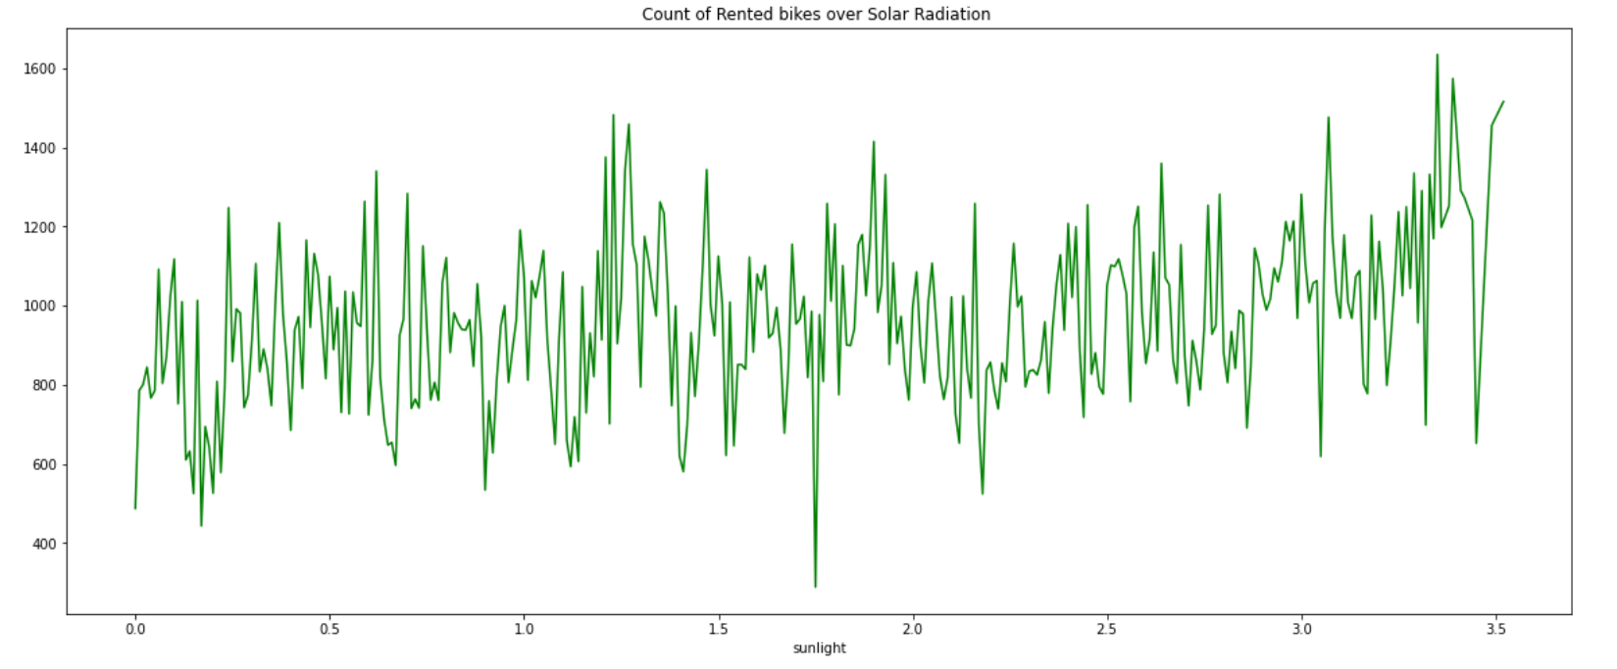
Bike rent count over Sunlight
The is no specific pattern in bike rent count over Solar radiation.

Slide 30
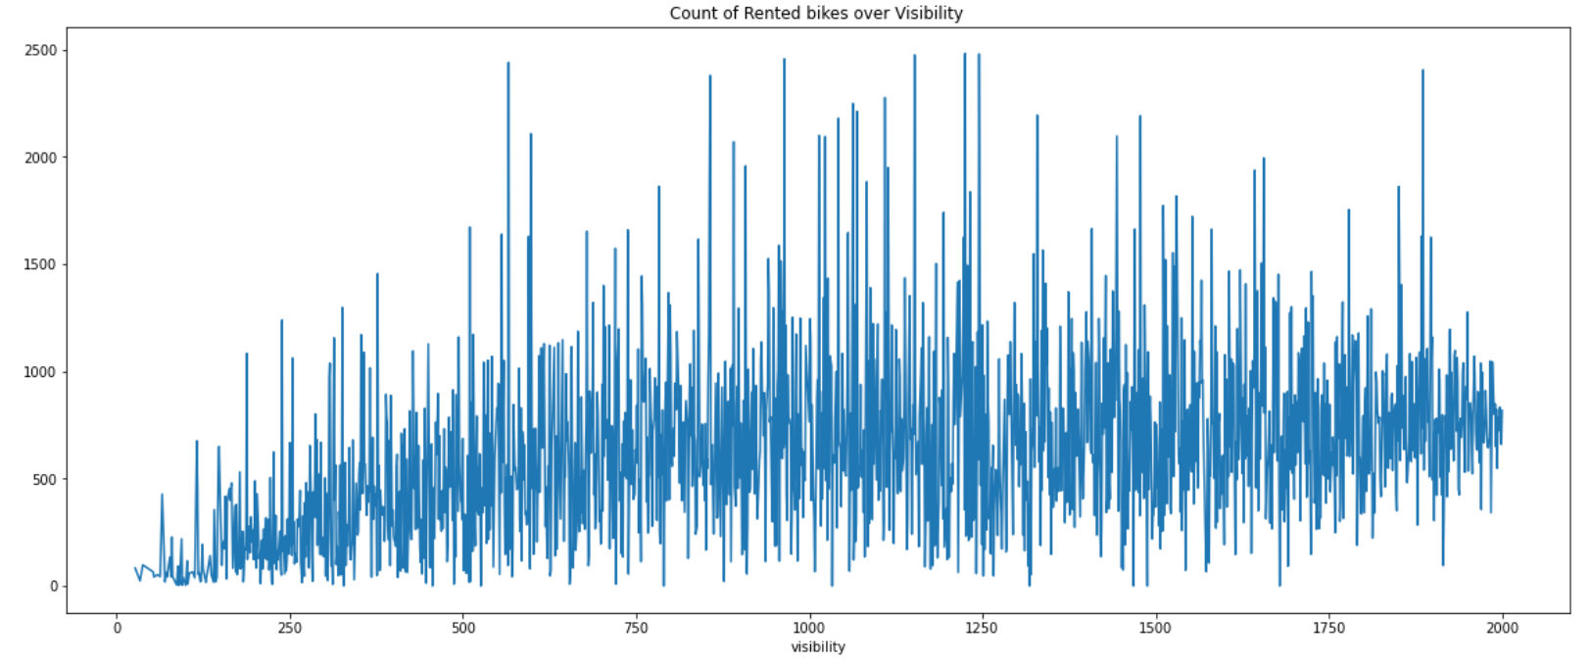
Bike rent count over Visibility
Initially the bike rent count increases but it becomes constant after a certain amount of visibility.

Slide 31
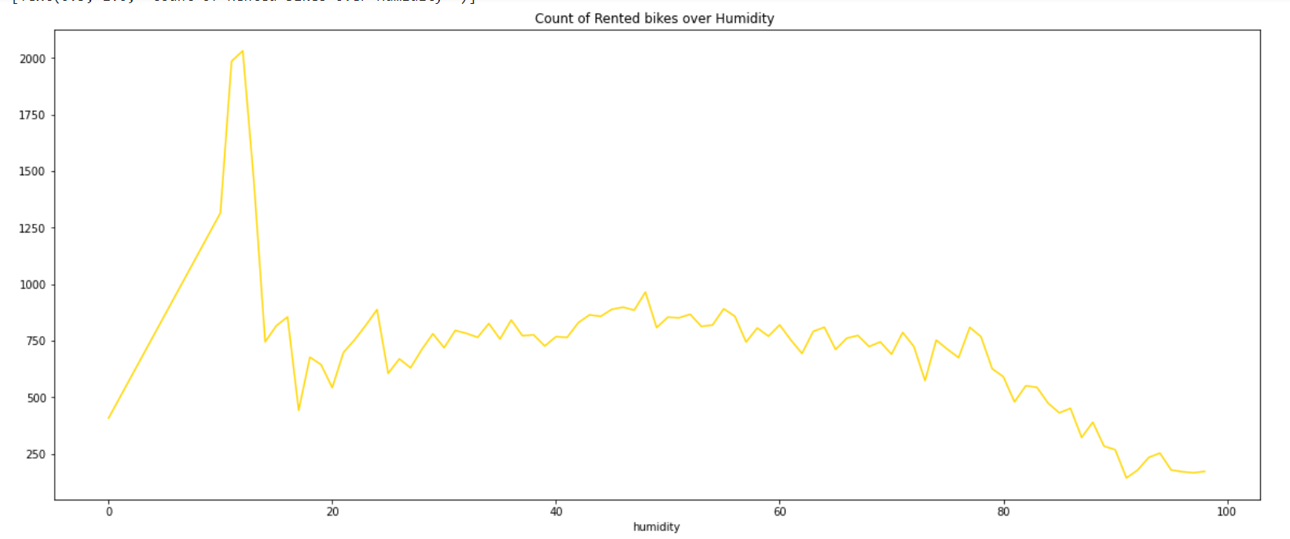
Bike rent count over Humidity
The initial surge indicates that this range of humidity is pleasant and after that, the bike rent count decreases slowly.

Slide 32
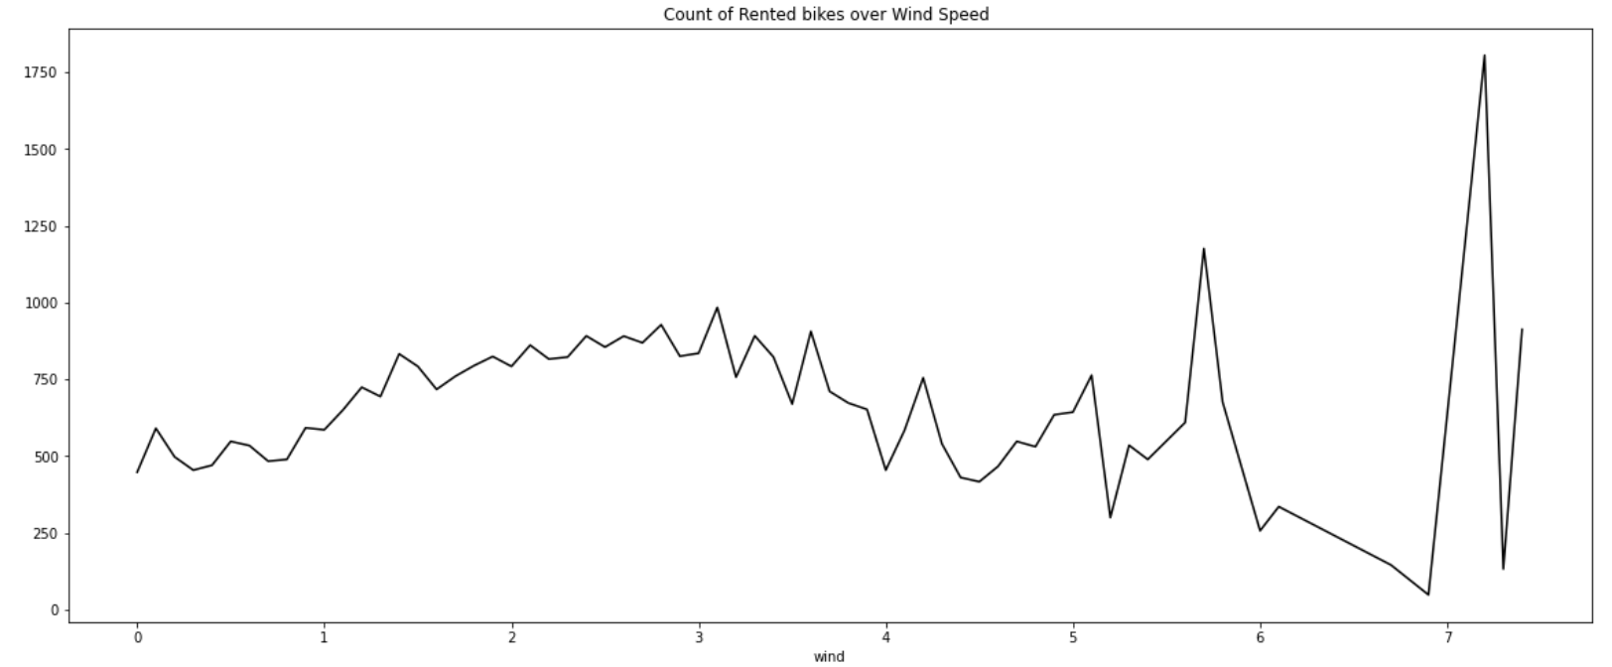
Bike rent count over wind speed
We can clearly see the spike at the end, indicating the outliers in the dataset.

Slide 33
3. Feature Engineering
Features understanding is the most important part of any analysis, while model-building identification and classification of a feature play an important role.
In regression we can not use a categorical variable as they are given, we convert the categorical variable into a numerical value. So that a regression model will run efficiently.
Here we will do the same, So let’s start it.

Slide 34
Creating copy and rest analysis
First, we will make a copy of the original dataset (data), and the rest analysis will be done on the copied dataset(data_new).
We have three categorical variables named season, holiday, and functioning day
One DateTime column.
And several numerical columns like bike_count, hour, temp, humidity, sunlight, rain, snow, visibility, wind, and dew_temp.

Slide 35
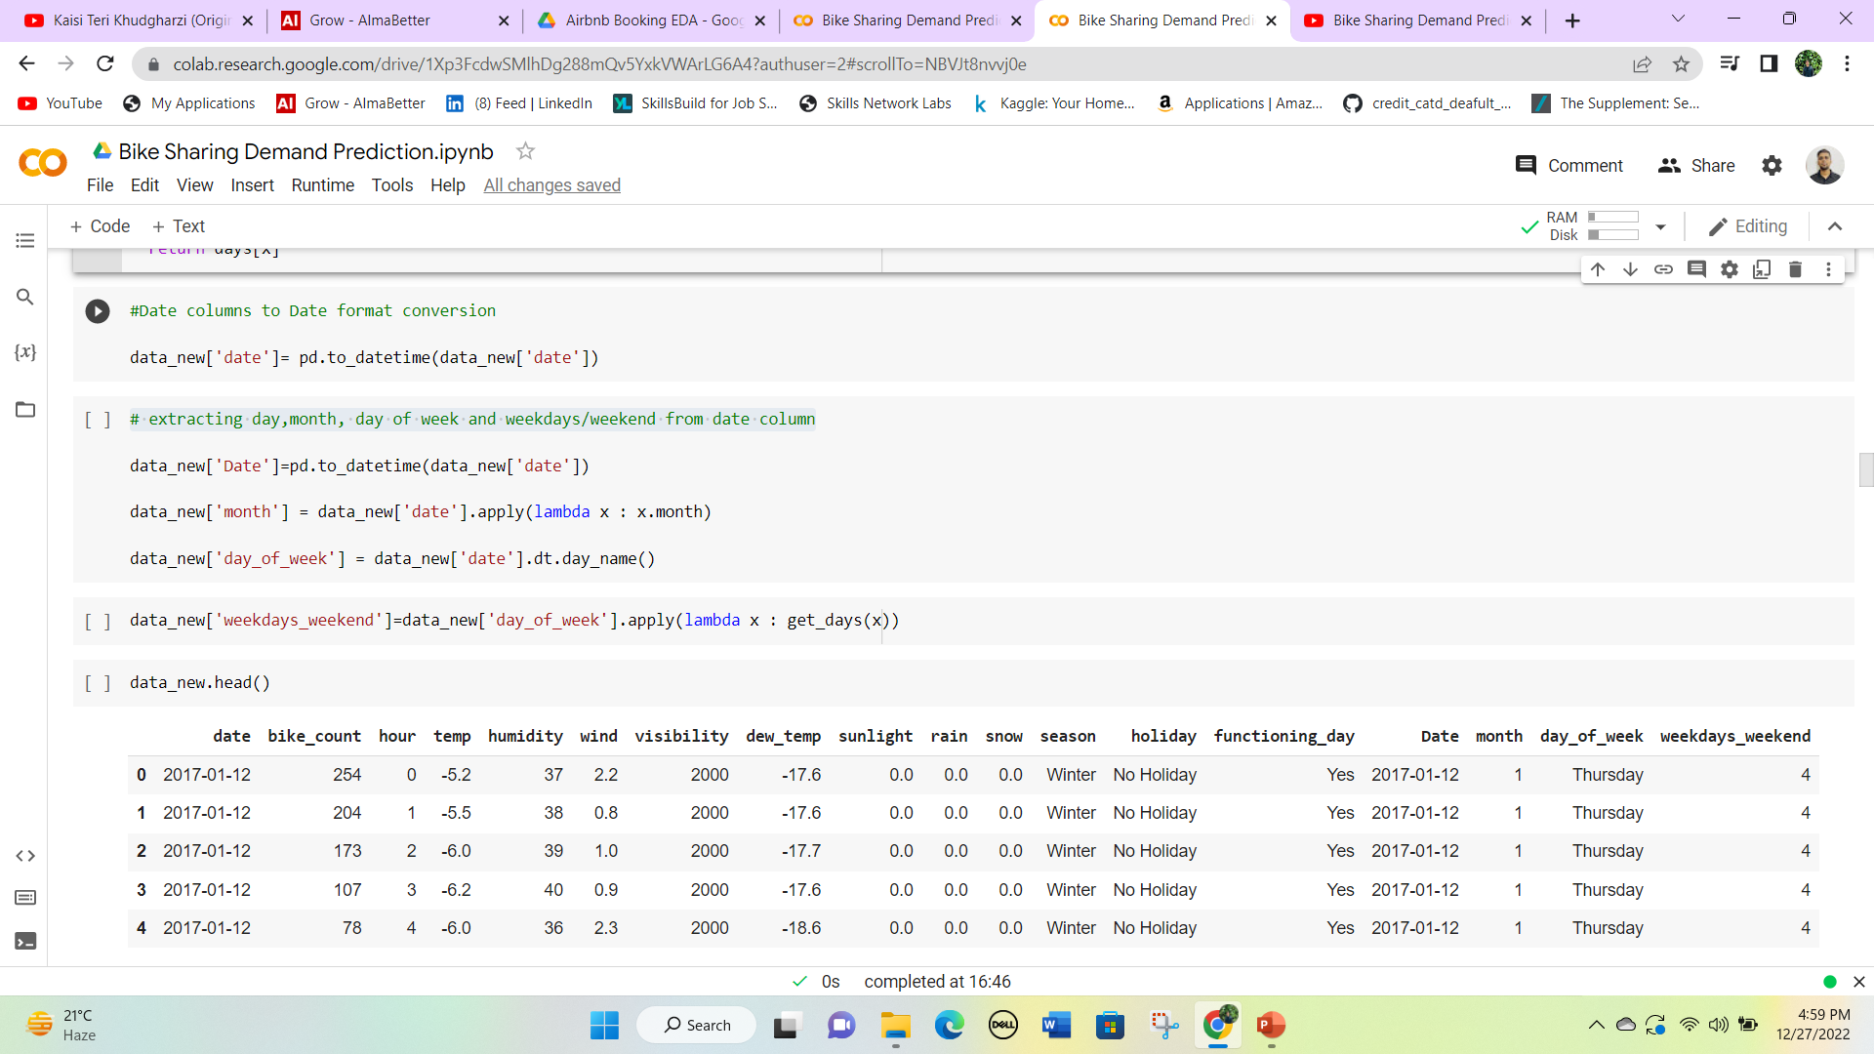
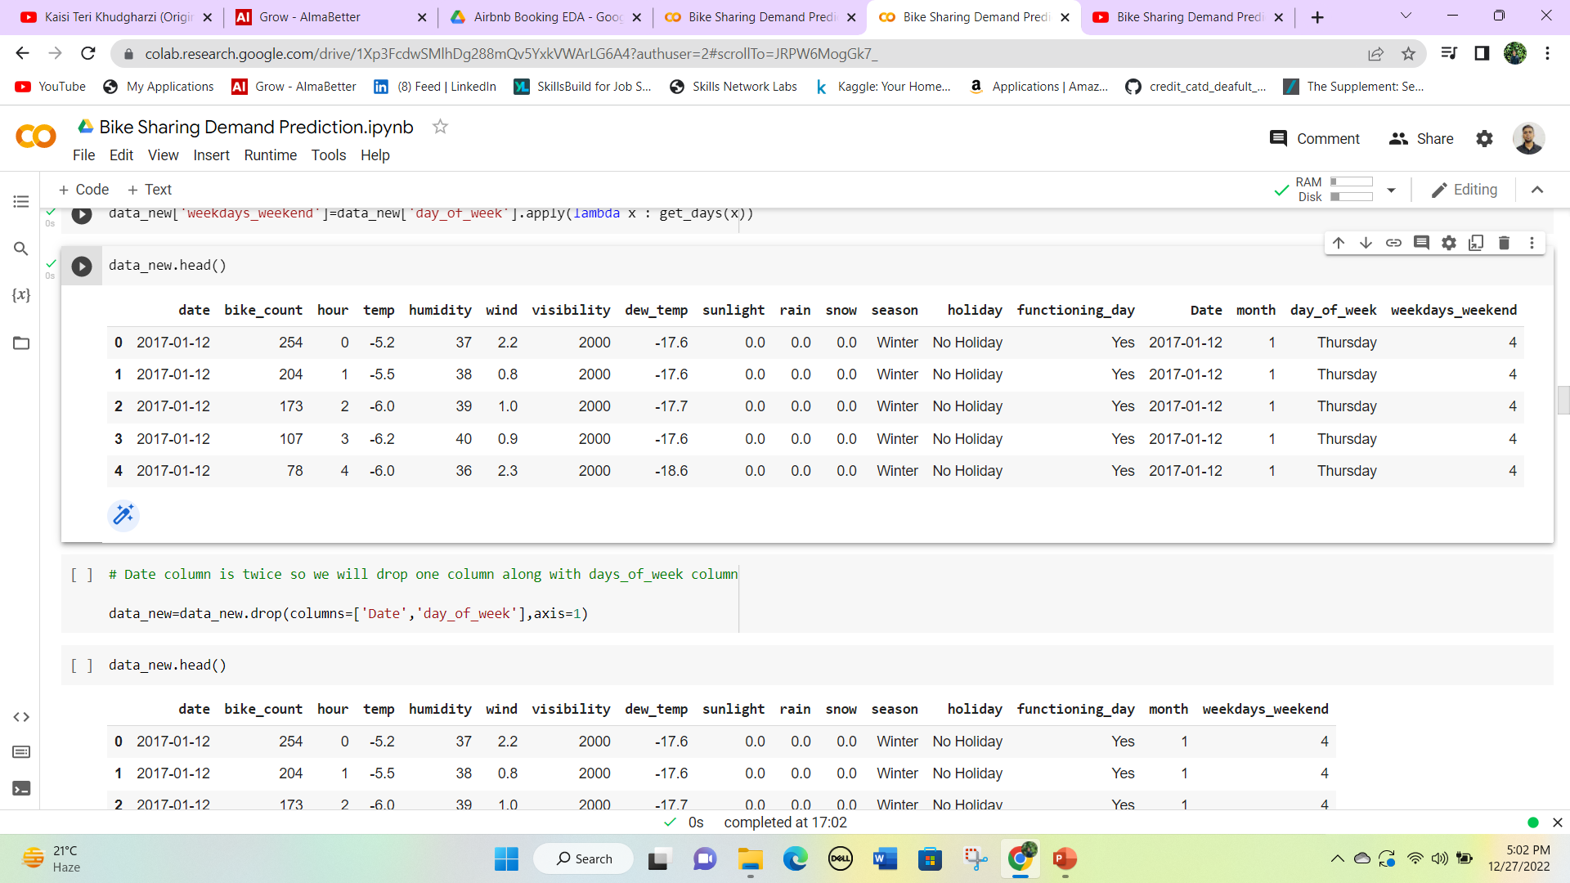
Extracting day, month, day of the week, and weekdays/weekend from the date column
The following codes will make three new columns named Date, month, and day_of_week.
With the use of a helper function we convert the day_of_week into a numerical column weekdays_weekends

Slide 36
Day number starts with 1 which is Monday and ends with 7 which is Sunday.
Month number 1 to 12 indicates January to December.
Our next target is to drop the unnecessary column day_of_week and the duplicate column ‘Date’.
Now our data is ready for the next step Analysis.

Slide 37
Continuous Feature Engineering
Our dependent variable is “bike_count" so we need to analyse this column with the other columns by using some visualization plot. First, we analyse the numerical data type.
continous_features = ['temp', 'humidity', 'wind', 'visibility', 'dew_temp', 'sunlight', 'rain', 'snow’]
Now we will try to visualize a regression line using a scatterplot for each continuous variable over the target variable.

Slide 38
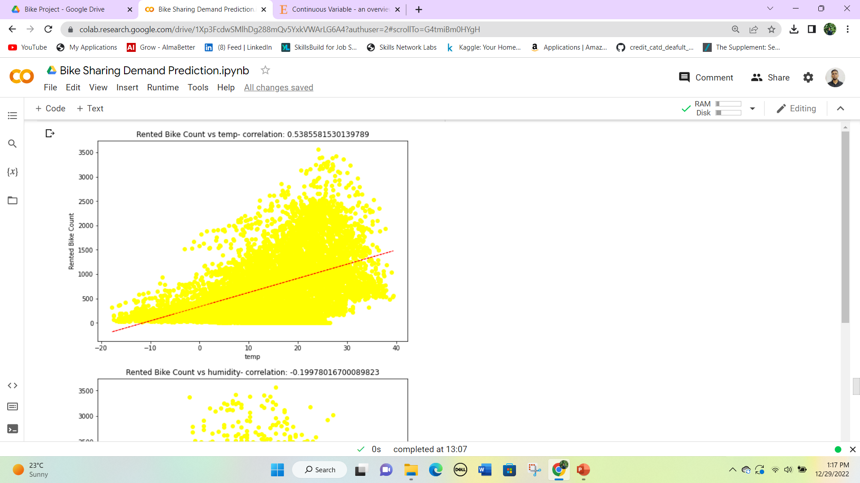
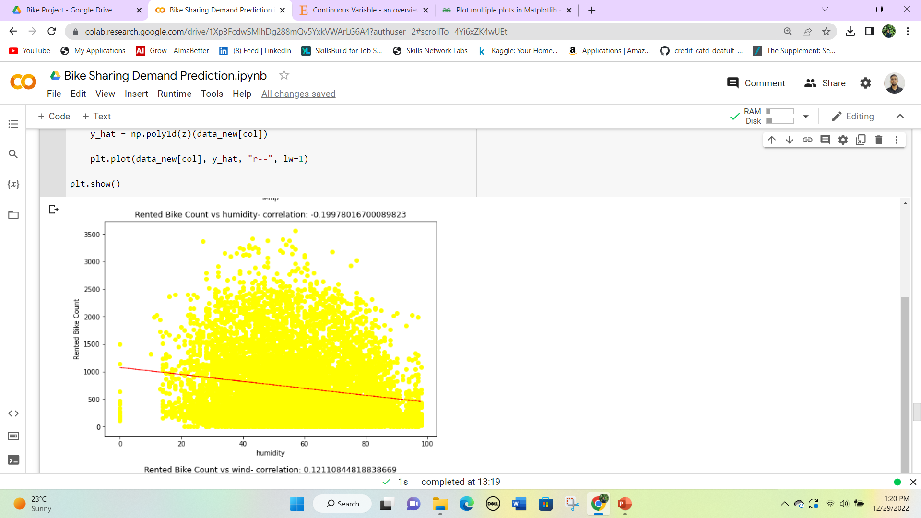
For temperature, it has a positive correlation with bike rent count while humidity has a negative correlation with bike rent count

Slide 39
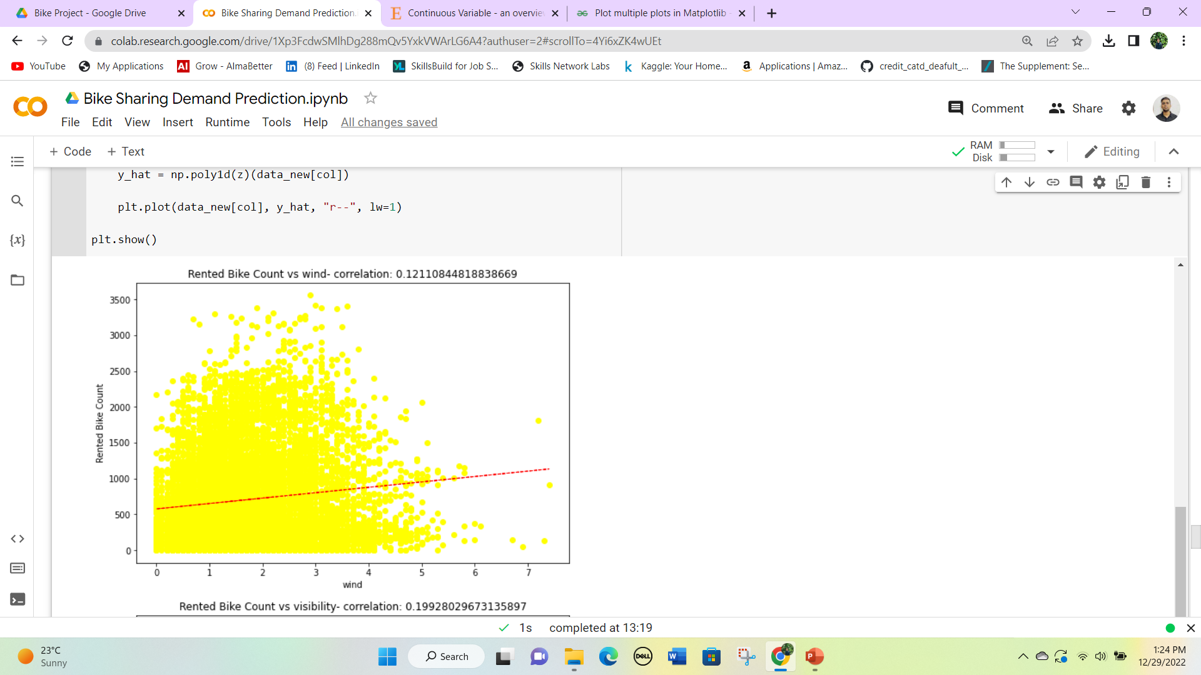
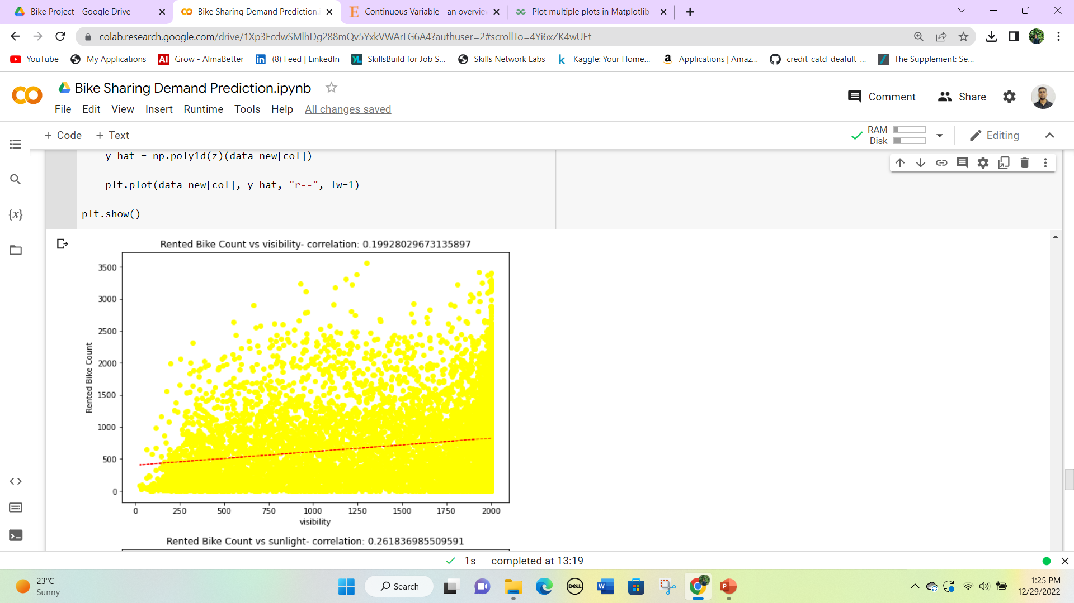
Both wind and visibility are little positively correlated with the target variable.

Slide 40
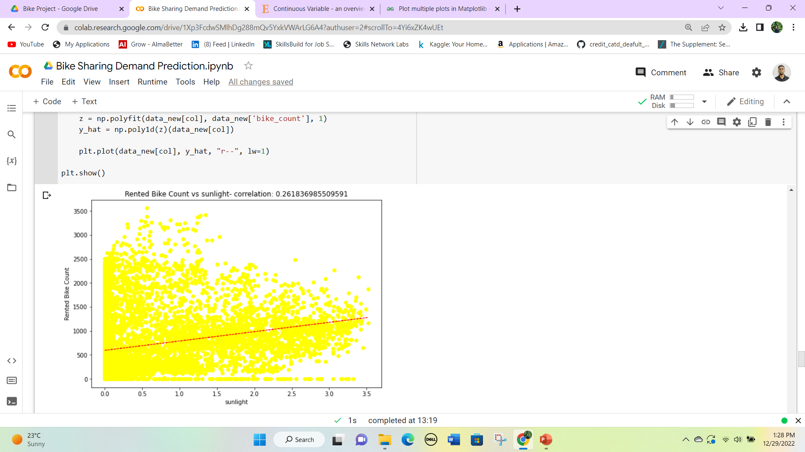
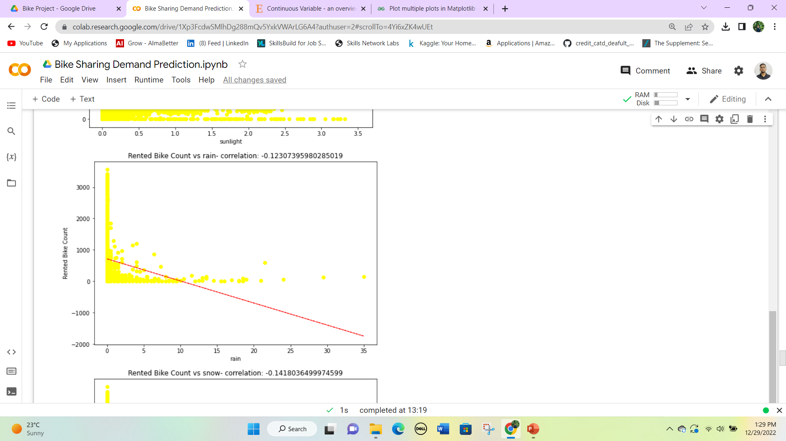
Sunlight has a positive correlation while the rain has little negative correlation with our target variable.

Slide 41
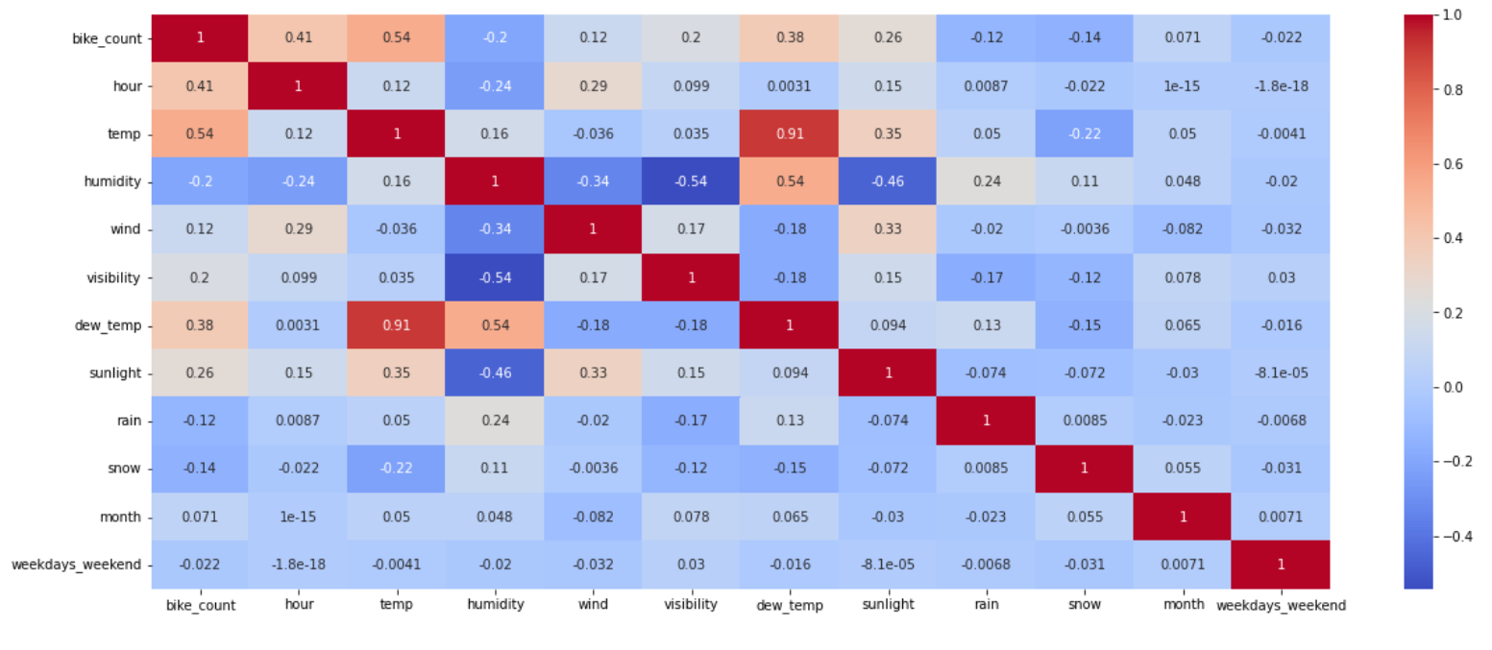
Correlation between different variables

Slide 42
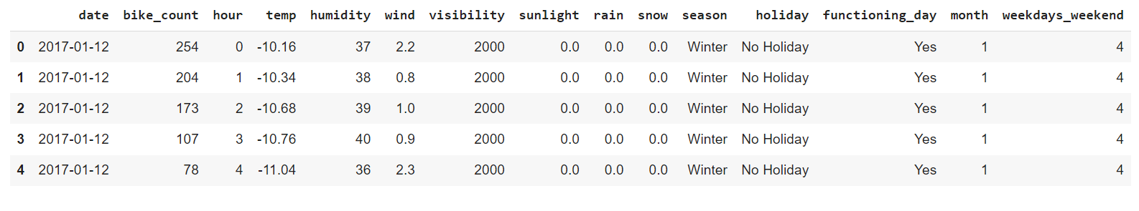
From the correlation matrix we can clearly see that dew temp and temp have a very positive correlation of 0.91, So we have to replace the temp feature using these two and drop the dew temp.
data_new['temp'] = 0.6*data_new['temp'] + 0.4*data_new['dew_temp’]
Now our data has no dew temp column.

Slide 43
Categorical Feature Engineering
Our dependent variable is “bike_count" so we need to do feature engineering of this column with the other columns by using some visualization plot. Now we will proceed with the categorical features.
categorical_features = ['hour','season','holiday','functioning_day', 'month', 'weekdays_weekend']
Now we will try to visualize the distribution of our categorical features using boxplot over the target variables.

Slide 44
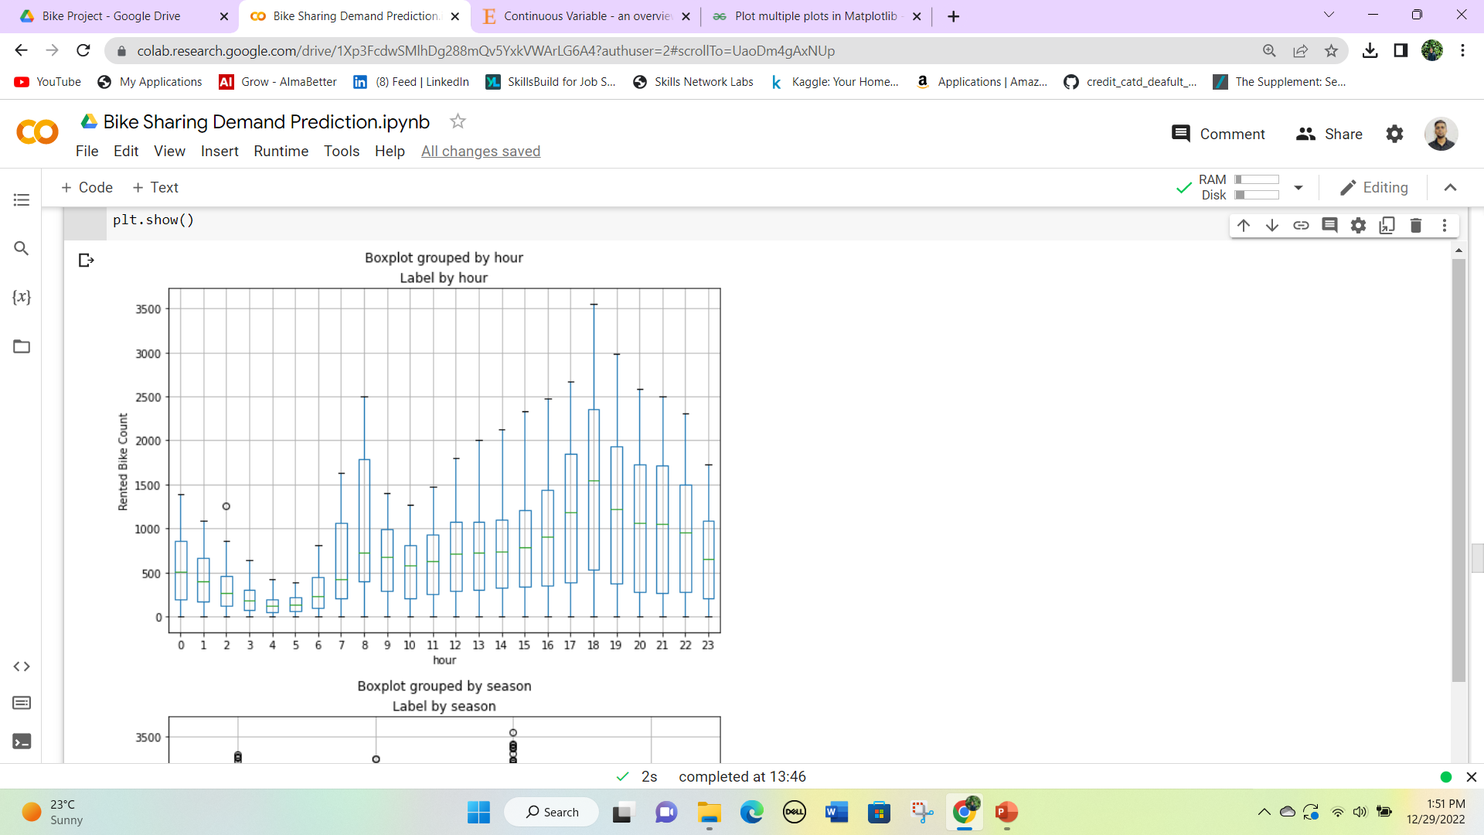
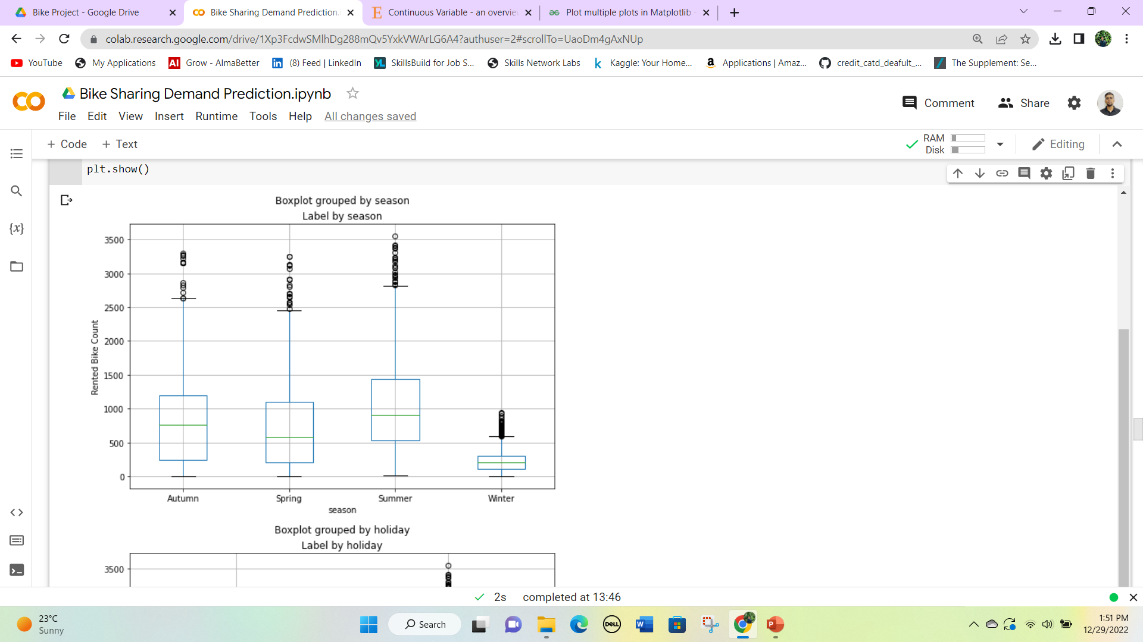
Hour column has no outliers while the seasons have outliers in each season type.

Slide 45
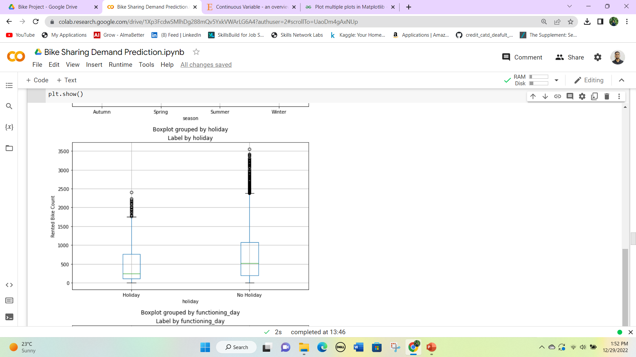
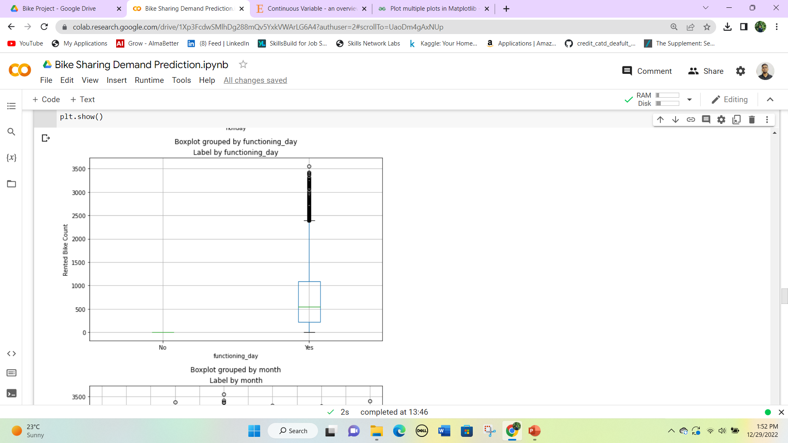
Holiday and functioning day both have so many outliers in the dataset.

Slide 46
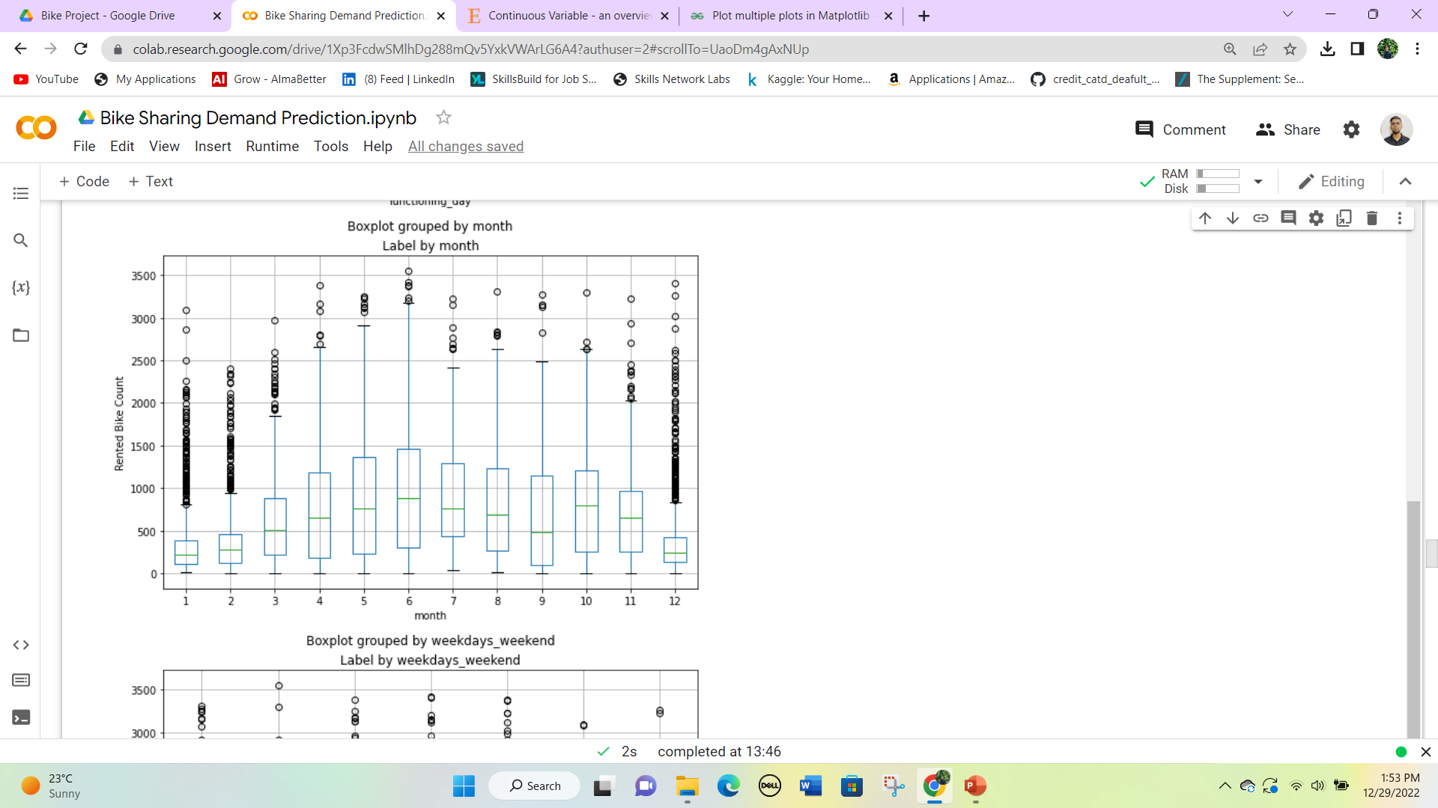
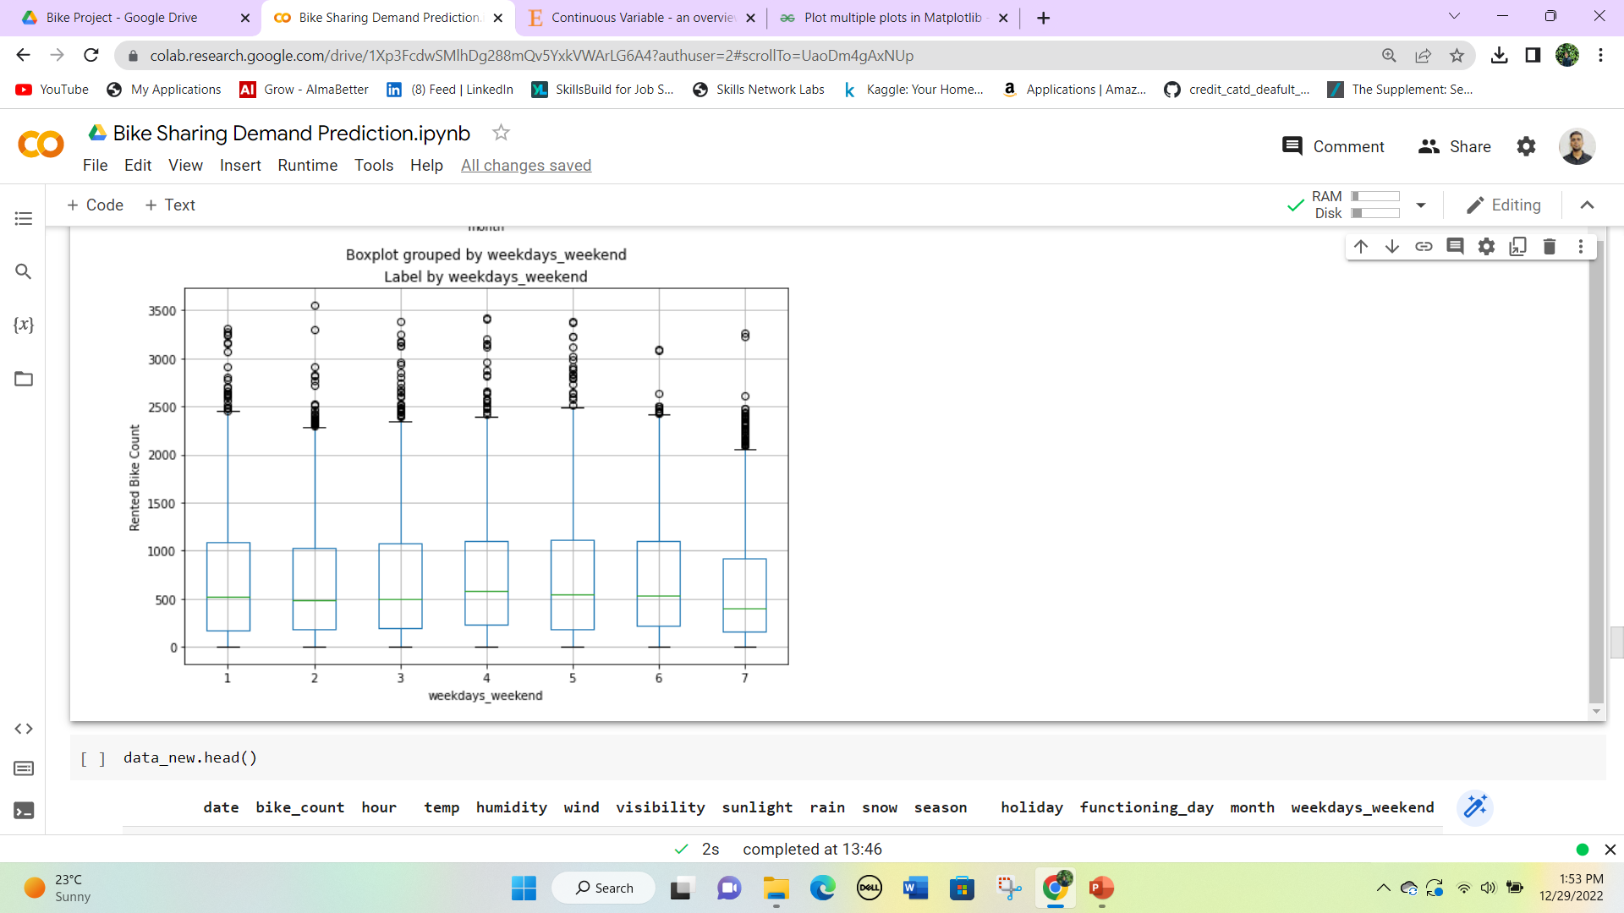
Month have most of the outliers in the month of Jan, Feb, and December while there is little a few outliers on the 6th day of the weekdays.

Slide 47
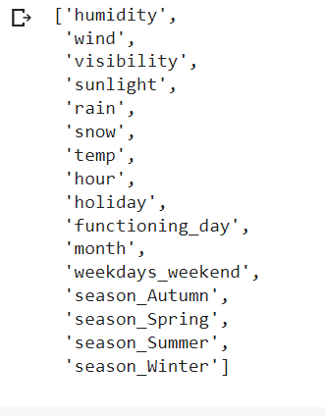
Encoding Categorical variables into numerical variables
Now we will transform all categorical variables season, holiday, and functioning day into numerical variables for regression modeling.
Now the total number of features in the dataset has become 16. these features will be used for regression modeling in the next step.

Slide 48
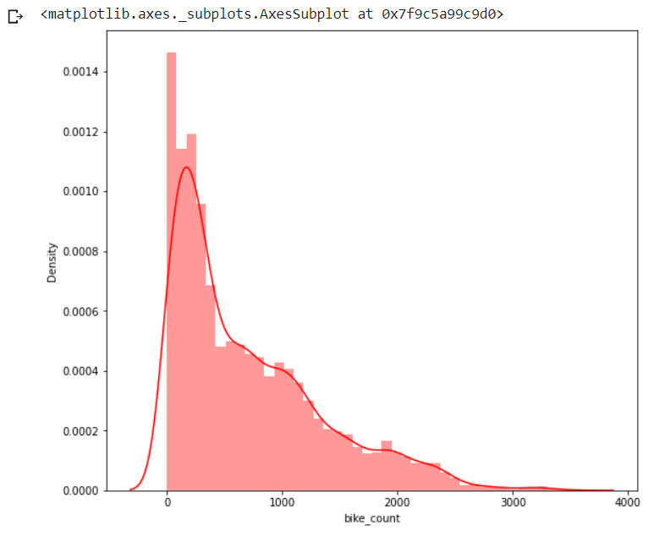
Distribution of target variable
A dependent variable is a variable whose value will change or depend on the value of another variable. Here our dependent variable is bike_count.
we found that the target variable is right-skewed, hence we will do a square-root transformation. So that we can study the target variable.

Slide 49
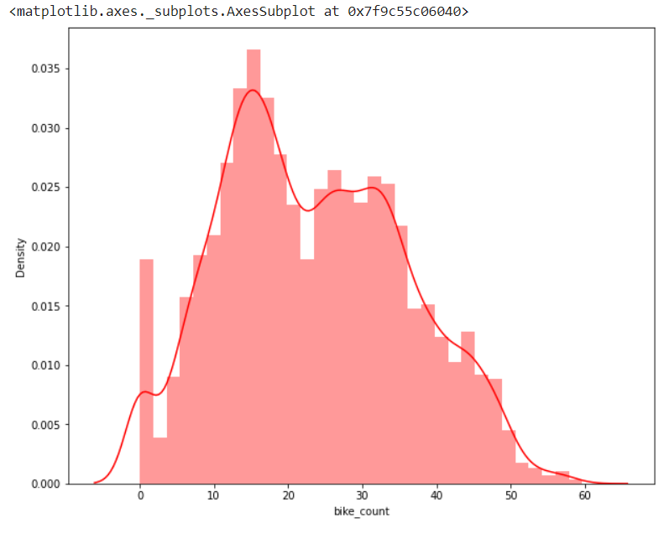
After square root transformation, the target variable is converted into a normal distribution.
Now our dataset is ready for model implementation.

Slide 50
4. Model Implementation
After all the hard work now we are going to the main work of this project that building a regression model.
This model will first train some part of the data and then we will test the model on the rest part of the data.
We will compare the actual and predicted values of each kind of model.

Slide 51
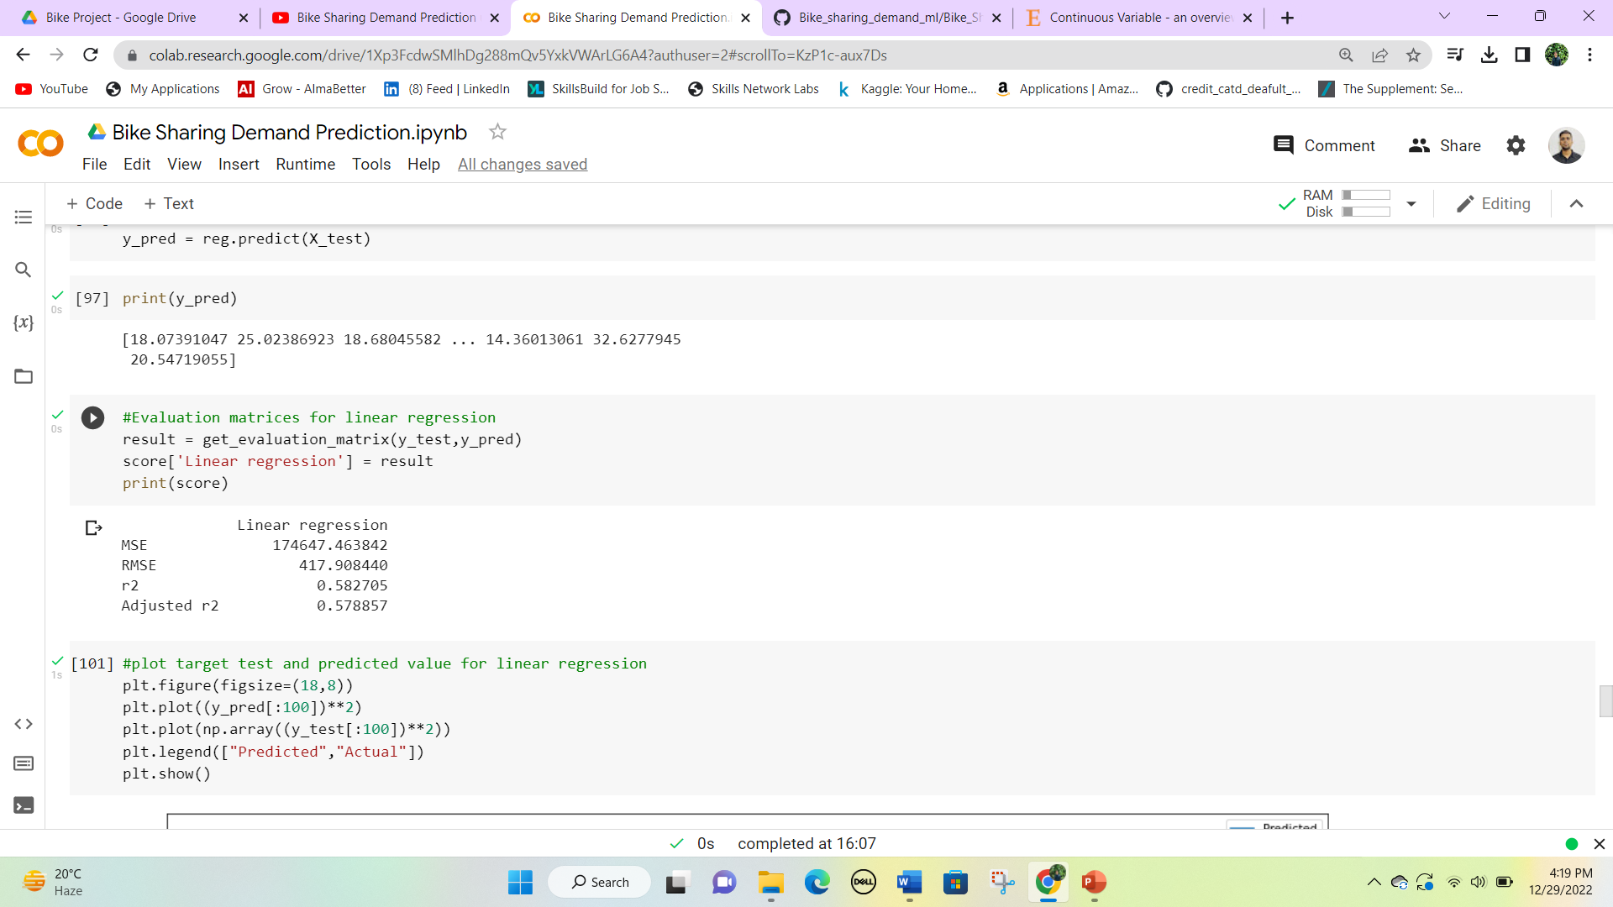
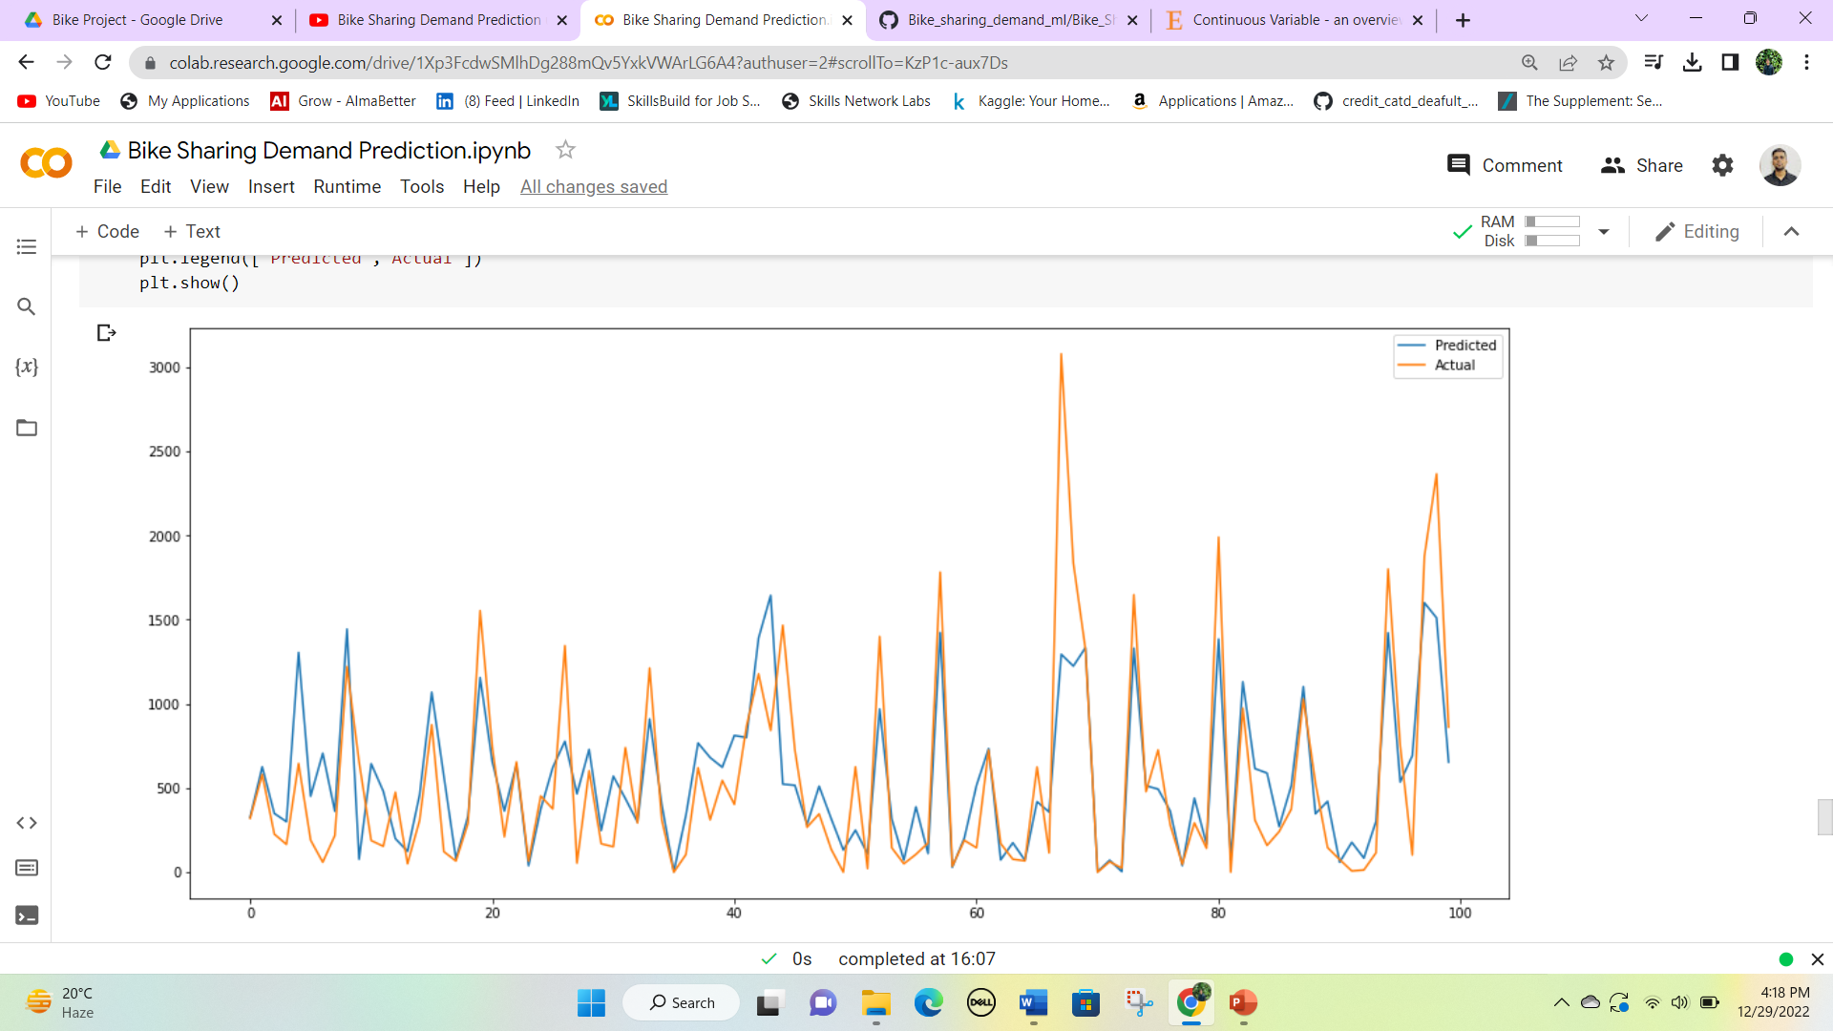
Linear Regression

Slide 52
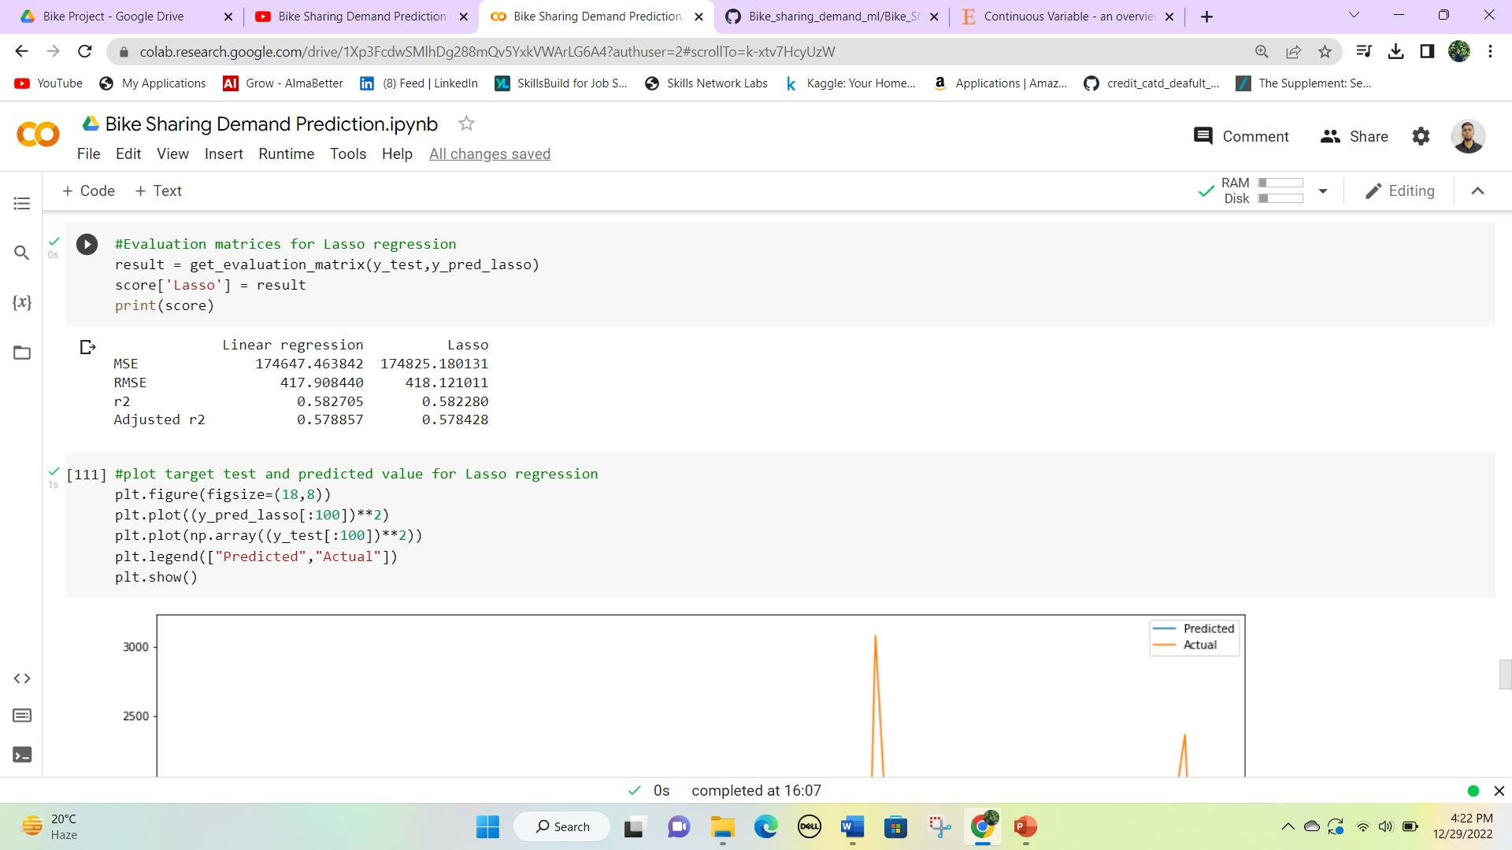
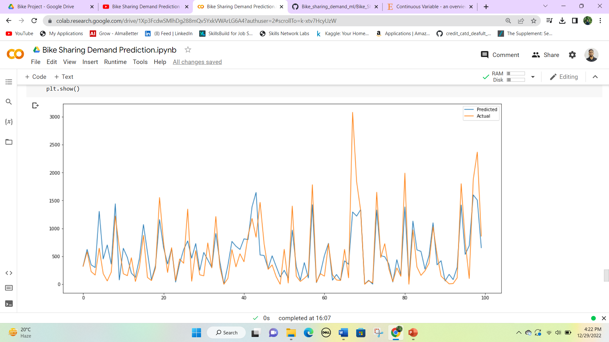
Lasso Regression

Slide 53
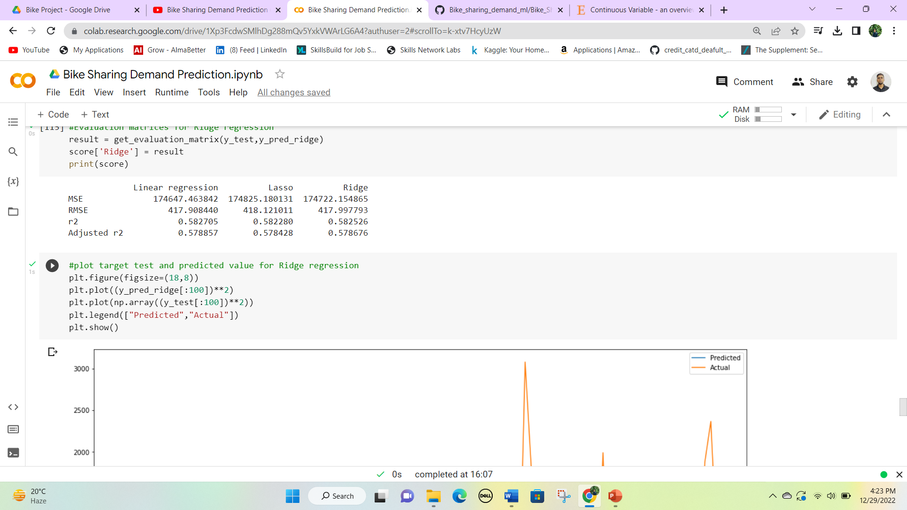
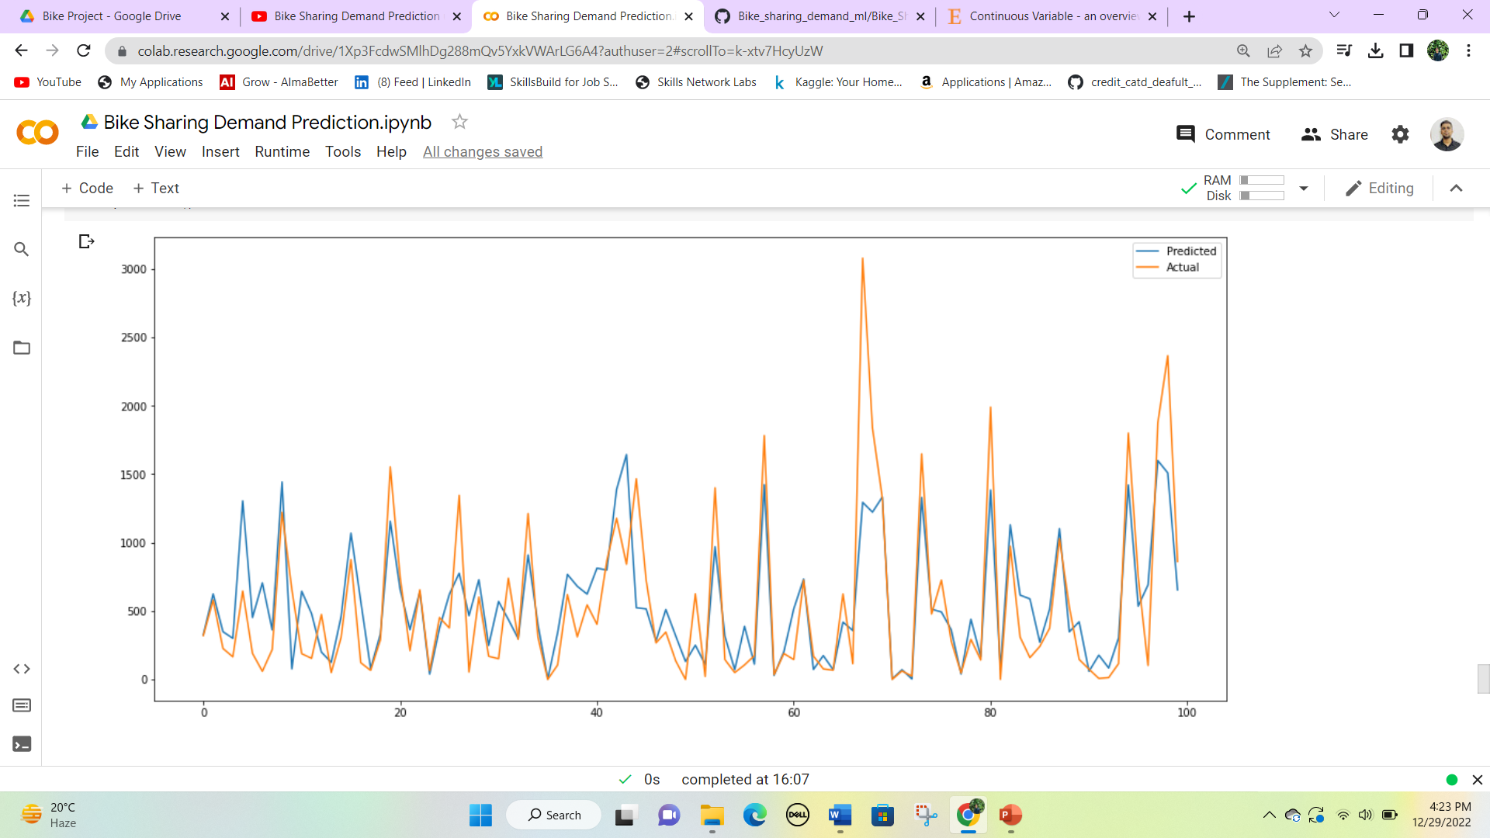
Ridge Regression

Slide 54
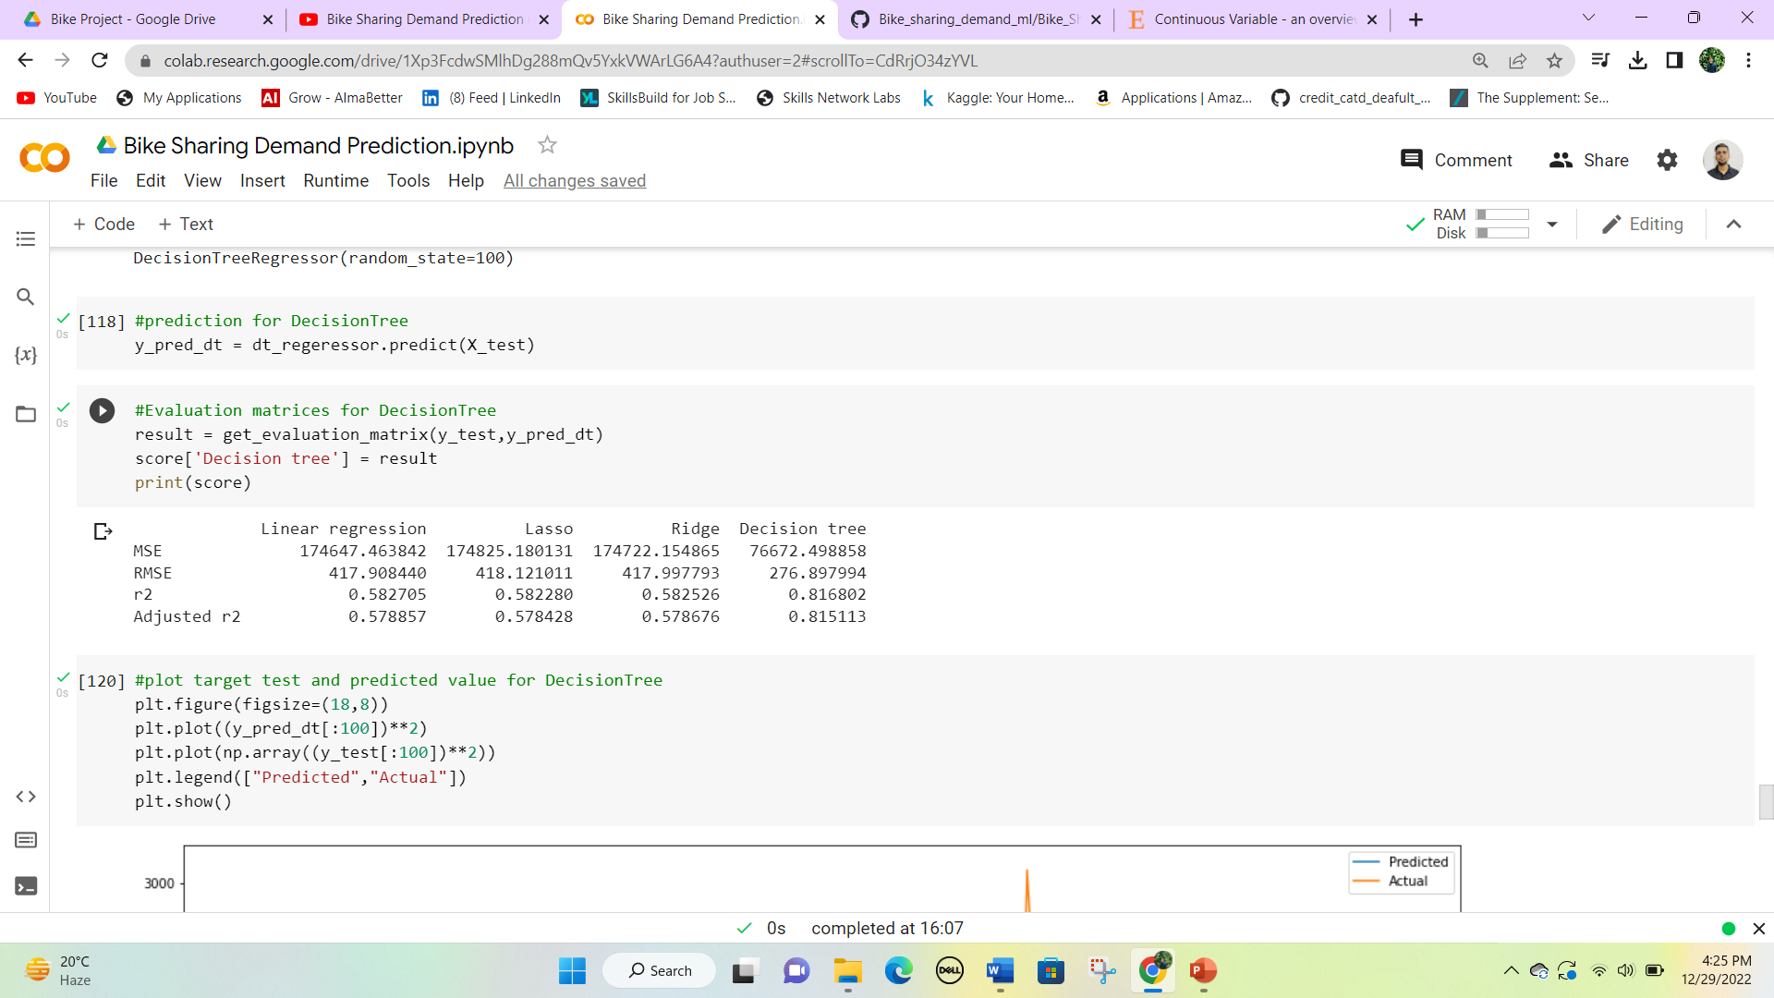
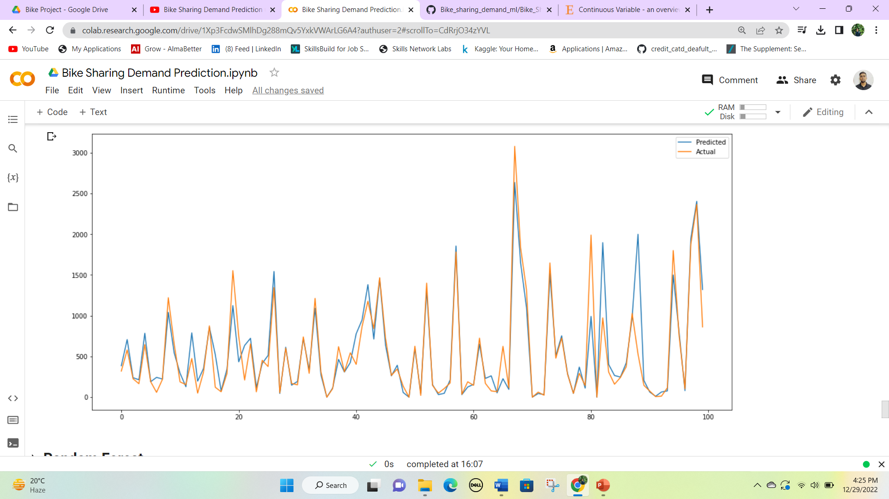
Decision Tree Regressor

Slide 55
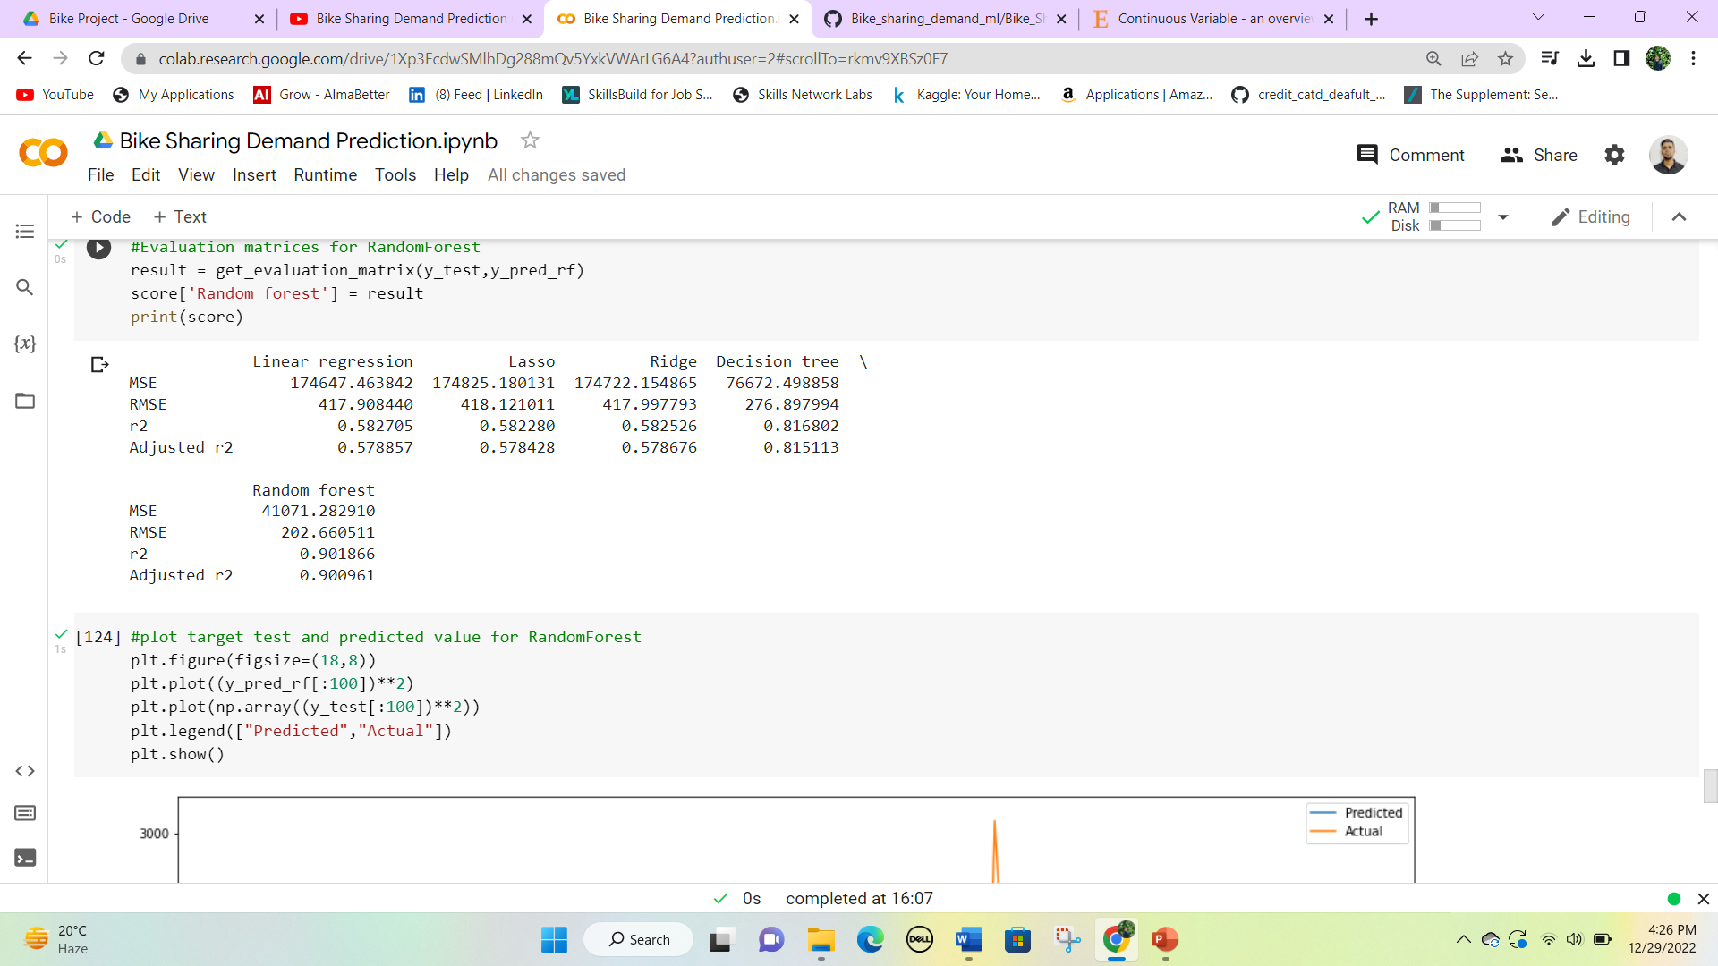
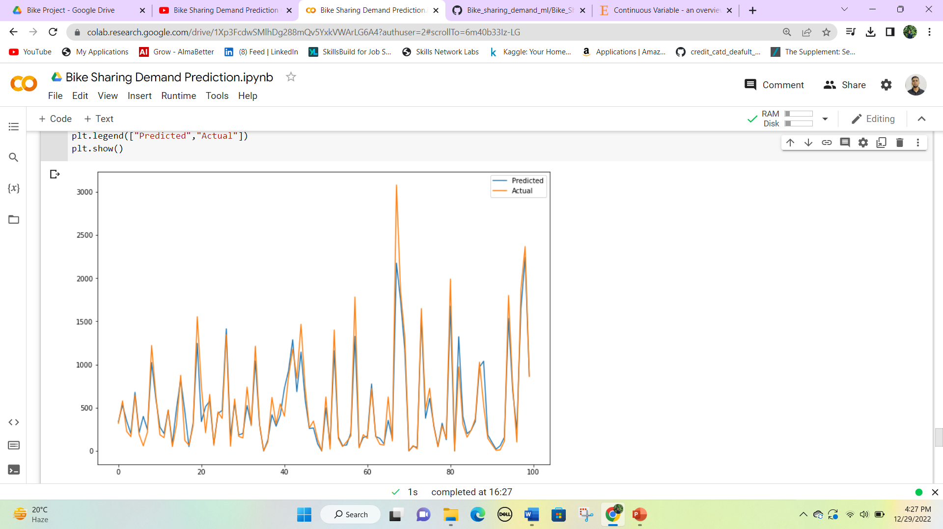
Random Forest Regressor

Slide 56


Gradient Boosting Regressor

Slide 57


Extreme Gradient Boost Regressor

Slide 58


Feature importance in different models
5. Model Explainability
Linear regression Random Forest

Slide 59

All models performance Comparison

Slide 60
Conclusion
Temperature is the most influencing feature and humidity is in second place for Linear Regressor.
Hour and seasons are the most important feature for the Decision Tree, Random Forest, and Gradient Boosting Regressor.
Functioning day is the most important feature and Winter is the second most for Extreme Boost Regressor.
R2 scores of the linear, lasso and ridge regression are similar.
R2 score of decision tree is 0.81 while r2 sore of random forest is 0.90.
XG Boost is acting differently from all the regressors as it is considering whether it is winter or not. And is it a working day or not? Though winter is also a function of temperature only it seems this trick of XG Boost is giving better results.
XG Boost Regressor has the Least Root Mean Squared Error of 185 and an r2 score or 0.91. So It can be considered the best model for the given problem.

